Slide 1

The future of crime prevention: police case analysis using machine learning
2023-224
31/10/2023
01

Slide 2
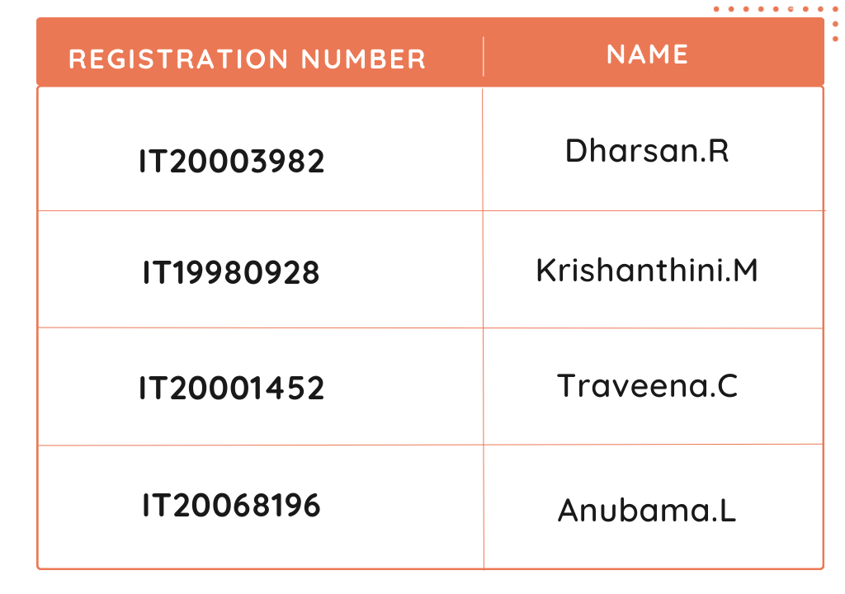
Team members
31/10/2023
02

Slide 3
01
02
Introduction
03
04
background
research problem
Objectives
Overall system diagram
05
INDIVIDUAL COMPONENT SECTION
31/10/2023
03

Slide 4

background
Rise of crime: Increasing challenge for police departments worldwide.
Traditional methods insufficient: Advanced tech needed for crime prevention and analysis.
Project aim: "The Future of Crime Prevention: Police Case Analysis using Machine Learning."
Components: Police accident case analysis, criminal case analysis, automated document classification, clustering crimes against women.
31/10/2023
04

Slide 5

Research problem
Analyzing and predicting accident locations and connections in police accident cases for effective safety measures and accident prevention is challenging due to the complexity and volume of data, making it difficult to manually identify patterns and determine the main causes of accidents in the present and future.
How can the system used to enhance criminal case analysis and prediction by identifying patterns and trends in the nature of crimes?
How can a comprehensive text analysis system be developed to assist police investigation in Sri Lanka to quickly and consistently discover important classification in crime occurrences?
How can clustering crimes against women be used to forecast potential future criminal activities and enhance public safety?
31/10/2023
05

Slide 6
objectives
main objective
Sub objectives
System to predict accident percentage for specified locations, predict accident percentage for causes, and analyze accidents and provide prevention strategies.
Analyze criminal cases to predict future crime rates by identifying patterns according to the nature of the crime.
Develop an automated text analysis system that classifies crime case files into relevant categories
Clustering crimes against women and crime forecasting prediction to take preventive steps
Develop a comprehensive machine learning system that can prevent and solve crimes by analyzing and predicting accident locations, criminal cases, clustering crimes against women and classifying police case documents. The system aims to enhance public safety by identifying patterns and trends in criminal activity, automating document classification, and providing interactive visualizations to forecast potential future criminal activities
31/10/2023
06

Slide 7
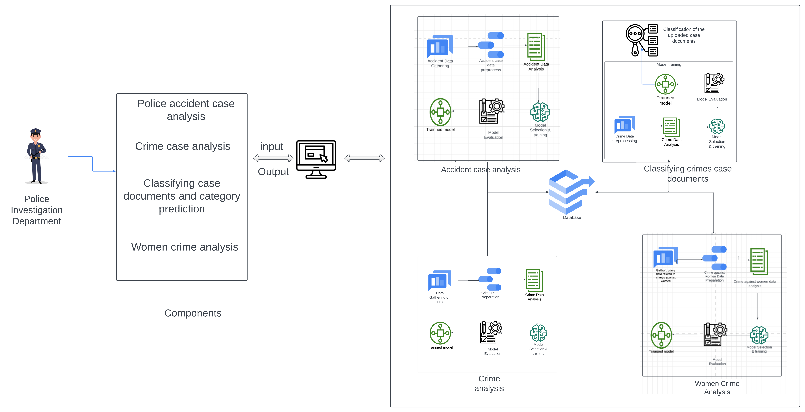
Overall system diagram
31/10/2023
07

Slide 8


IT20003982
Dharsan.r
Specialization: Software Engineering
31/10/2023
08

Slide 9
01
02
Introduction
03
04
background
research problem
objectives
methodology
05
Completion of the project
31/10/2023
09

Slide 10



background
The methods used in policing and accident investigation are no longer effective in dealing with today's complex nature of crimes and accidents
The field of police investigation has undergone significant changes in recent years with the increasing reliance on technology and data analysis to solve crimes.
Machine learning is a powerful tool in police investigation, processing vast data to identify patterns and trends for predicting and preventing accidents.
31/10/2023
10

Slide 11

Research problem
How can machine learning models accurately predict future accident locations and identify high-risk areas for accidents?
How effective are machine learning algorithms in identifying correlations and connections in accident data that may be difficult for humans to detect?
How can the police accident case analysis system be integrated with existing police accident investigation procedures?
31/10/2023
11

Slide 12
objectives
main objective
Sub objectives
Develop a machine learning system that can analyze and predict accident percentage for specified location, determine the causes of accidents and perform additional analysis in order to make some targeted safety measures and accident prevention strategies.
Analyze accident case data using machine learning techniques.
Predict accident percentage for locations for future years, predict causes of accidents, accident analysis.
31/10/2023
12

Slide 13
01
02
METHODOLOGY
03
04
SYSTEM DIAGRAM
TECHNOLOGIES
REQUIREMENTS
WBS
31/10/2023
13

Slide 14
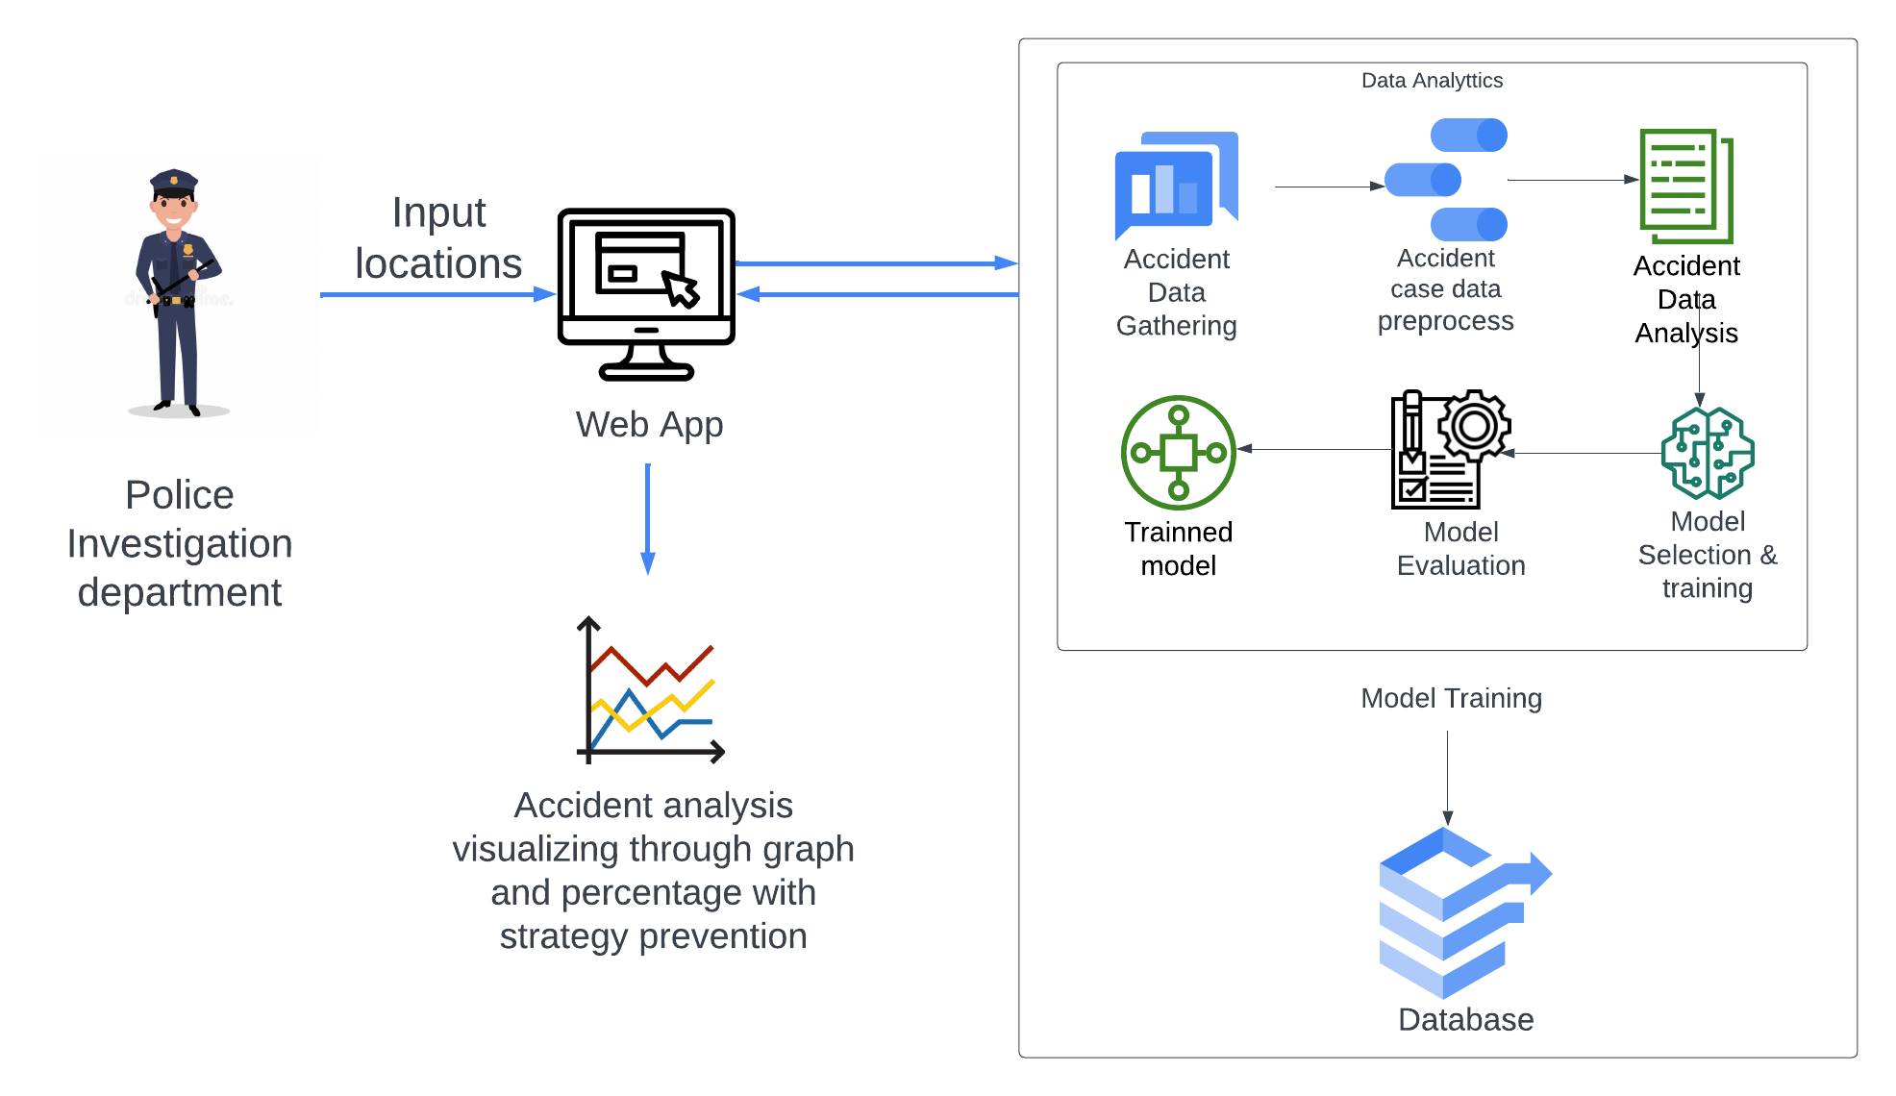
System diagram
31/10/2023
14

Slide 15






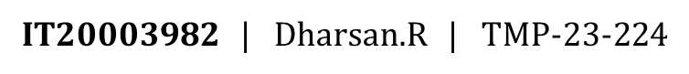
TECHNOLOGIES
31/10/2023
15

Slide 16
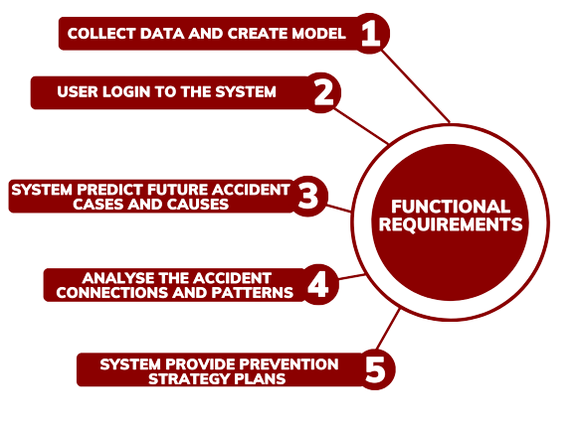
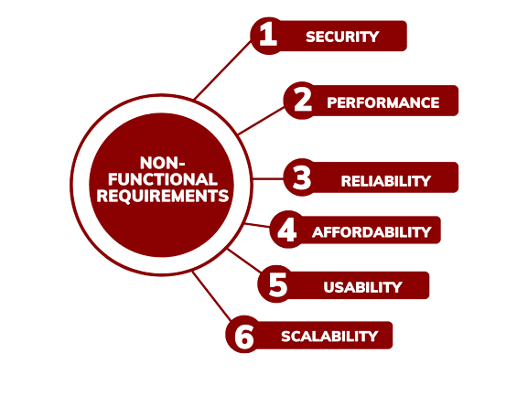

REQUIREMENTS
31/10/2023
16

Slide 17
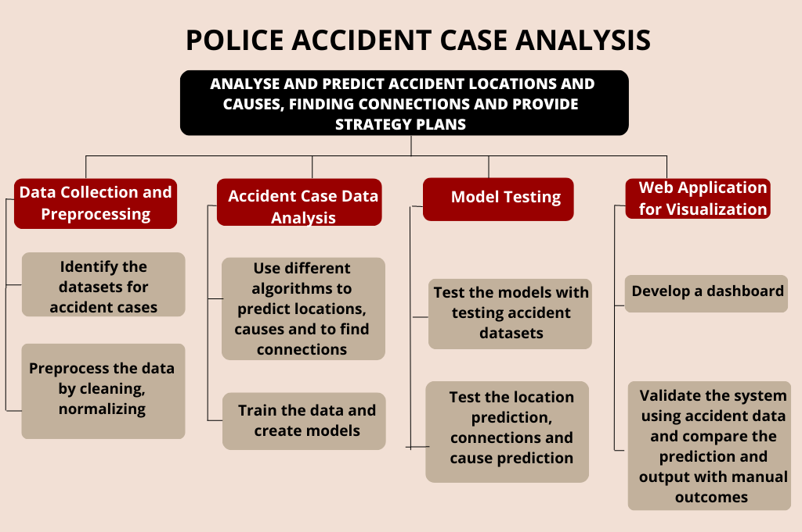
WBS
31/10/2023
17

Slide 18
Completion of the project
31/10/2023
18

Slide 19
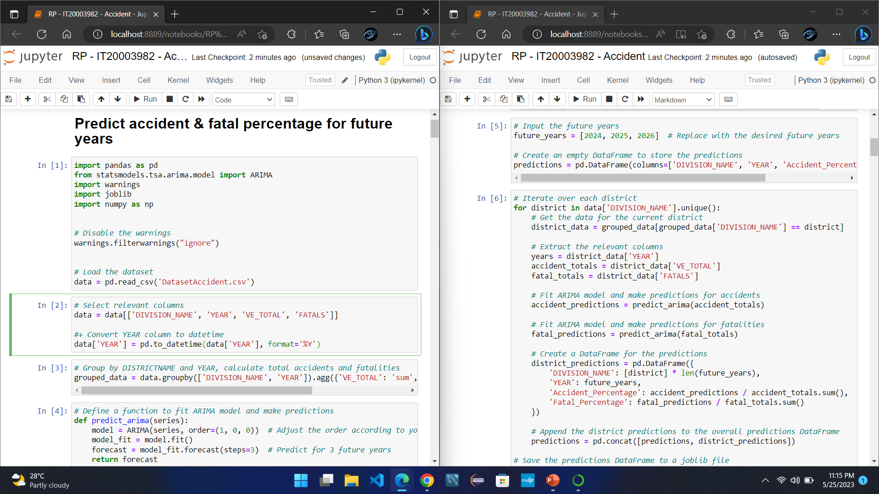
50% Completion OF THE PROJECT
31/10/2023
19

Slide 20
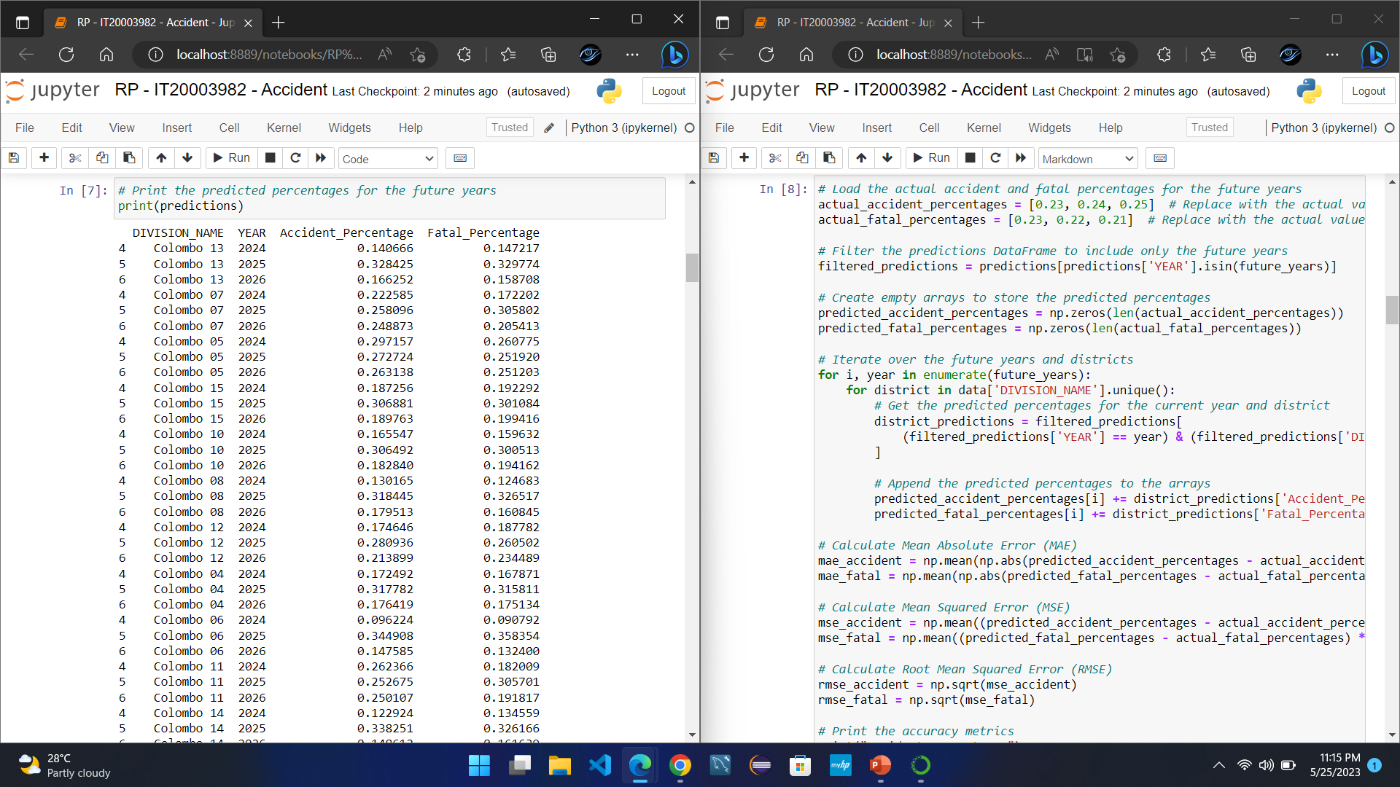
31/10/2023
20

Slide 21
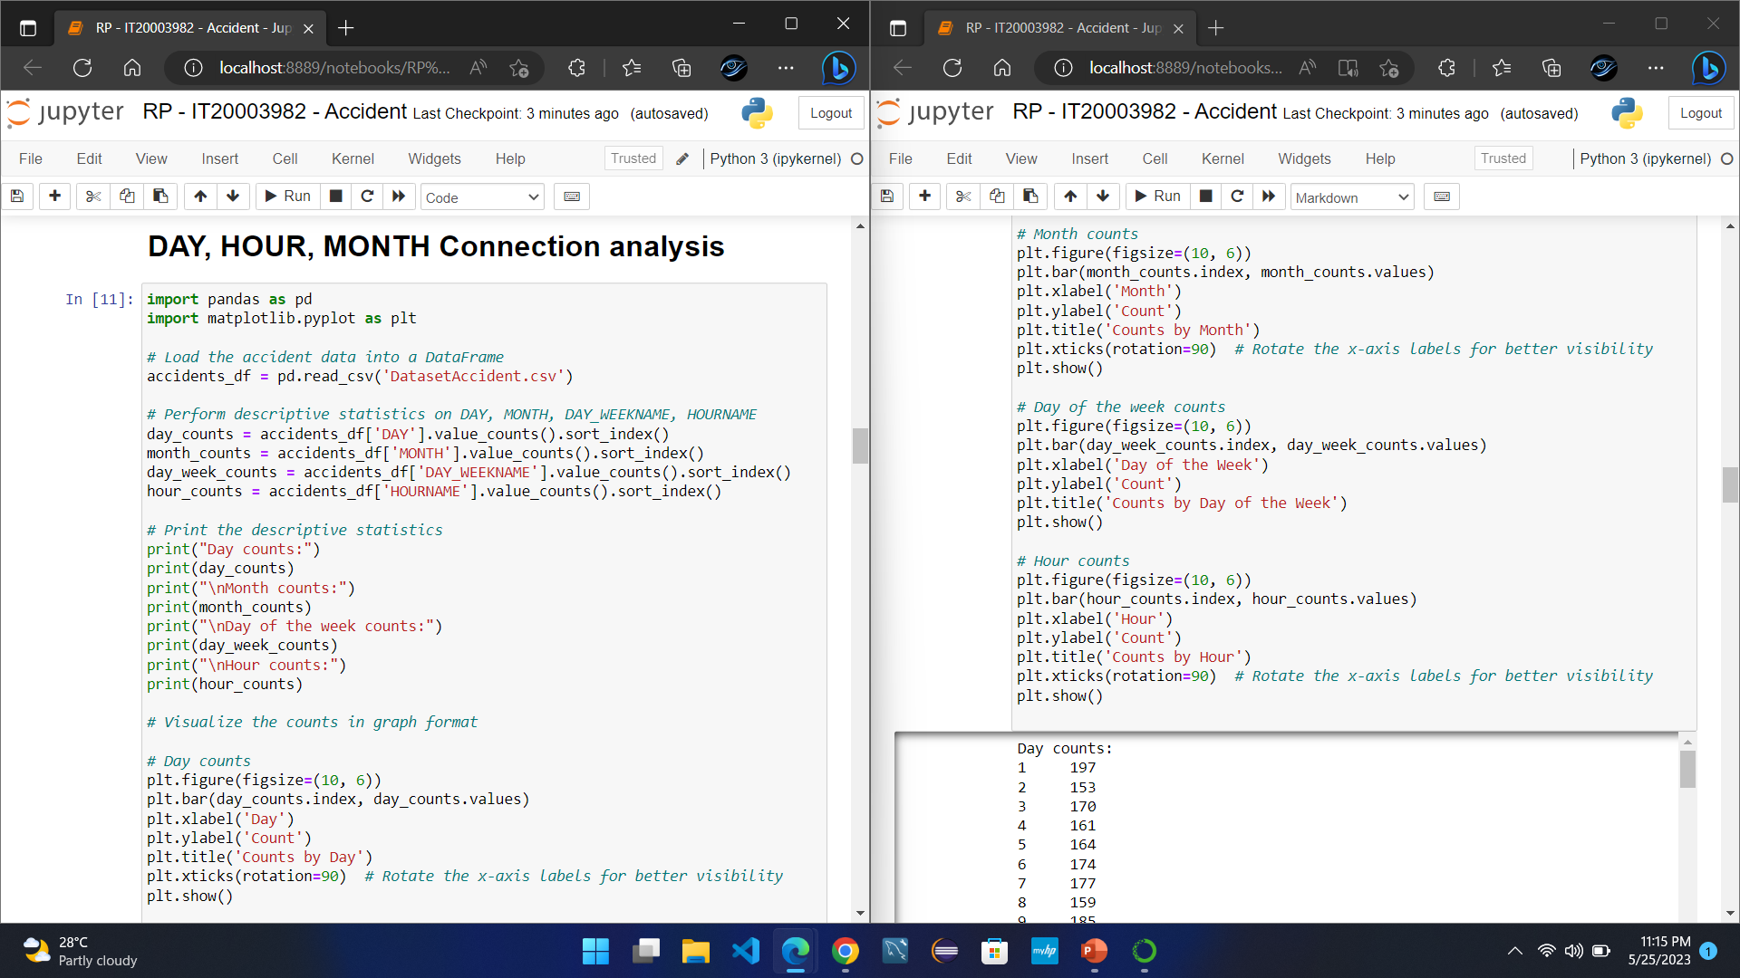
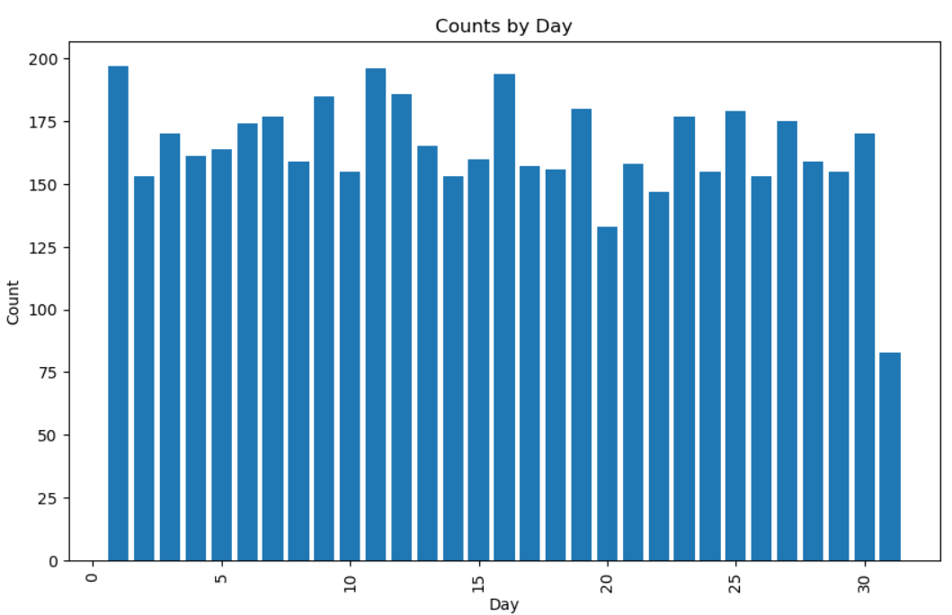
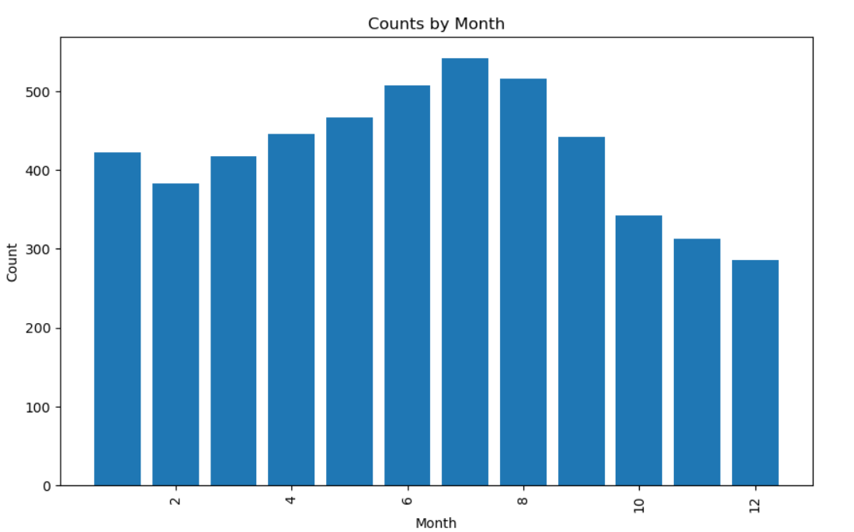
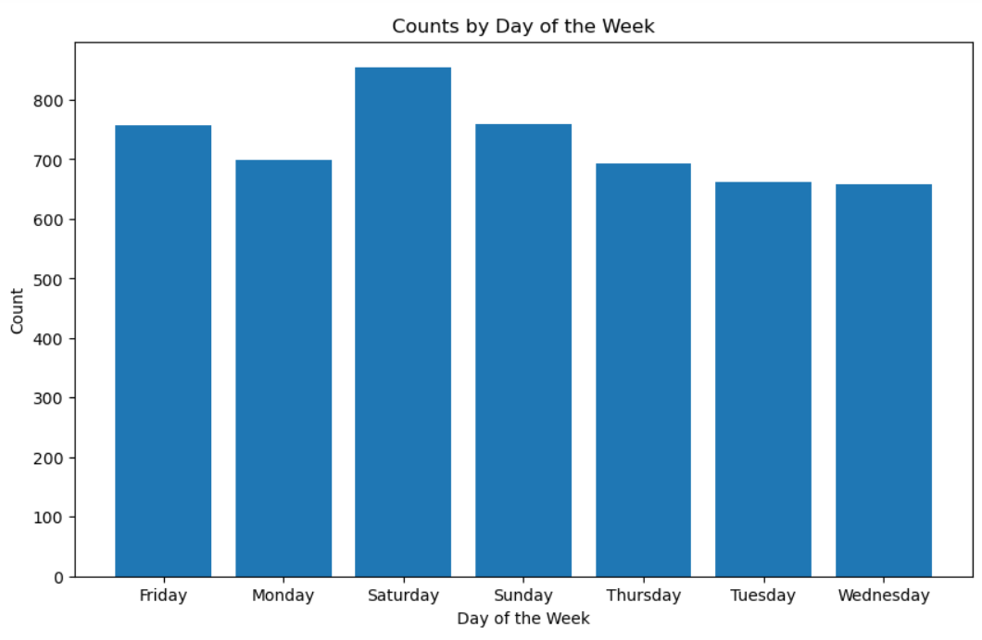
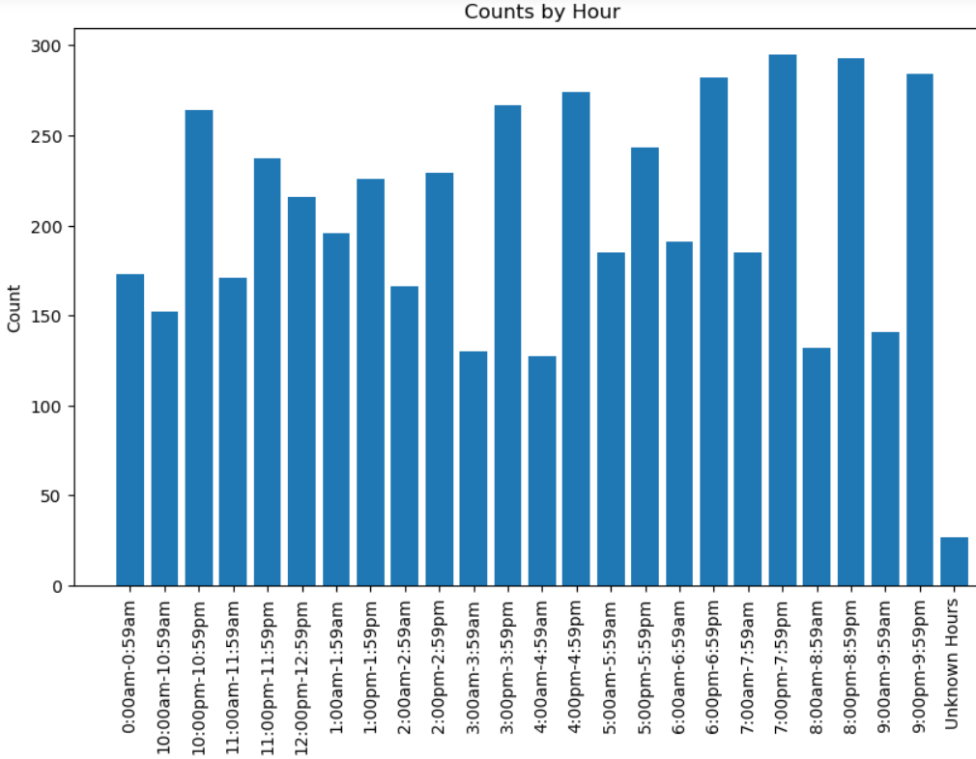
31/10/2023
21

Slide 22
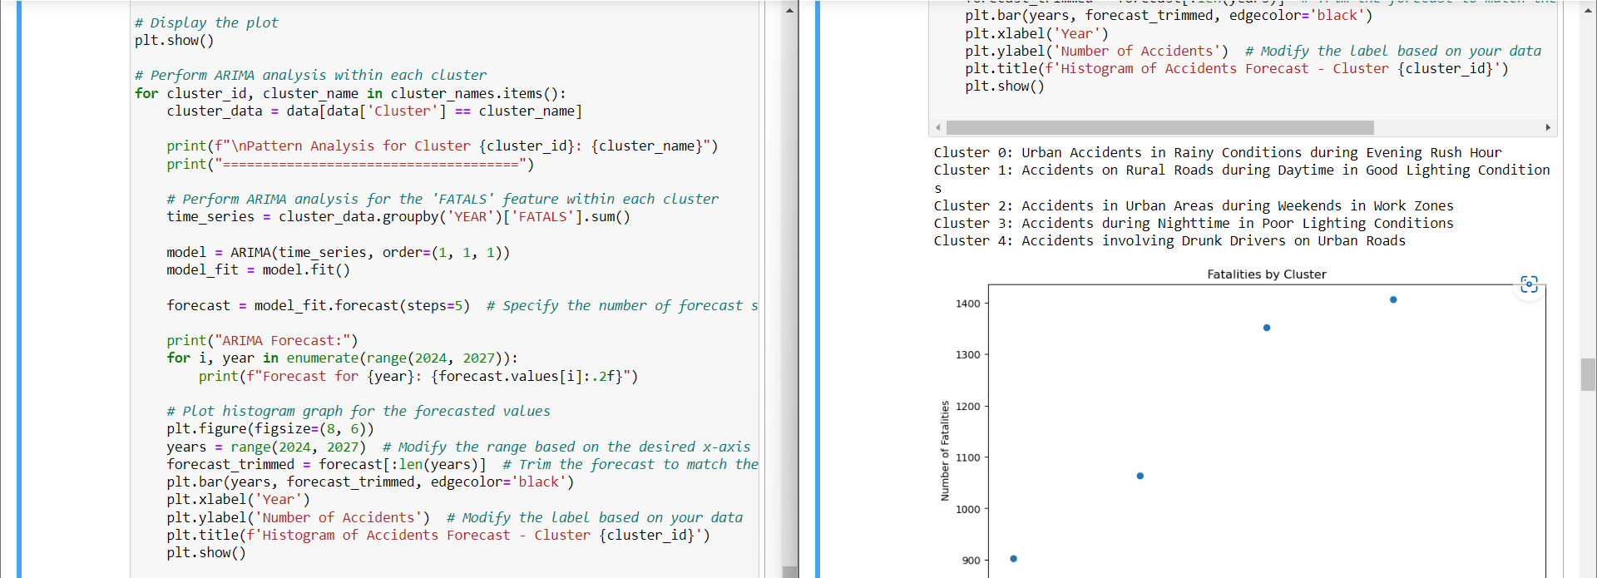
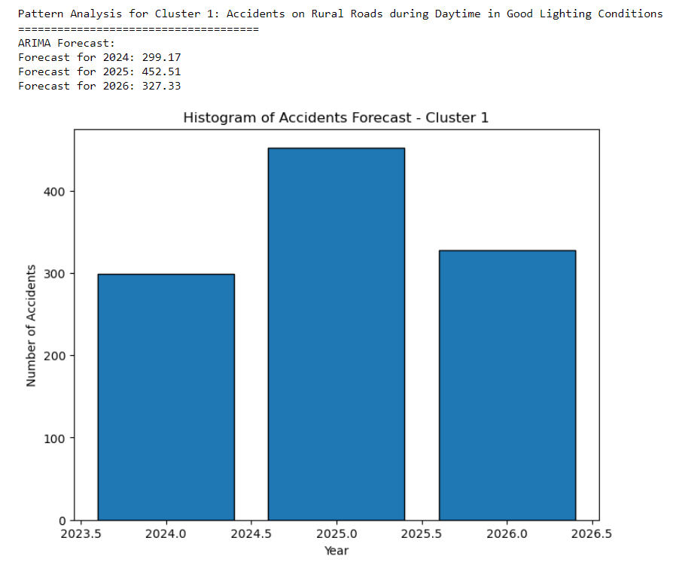
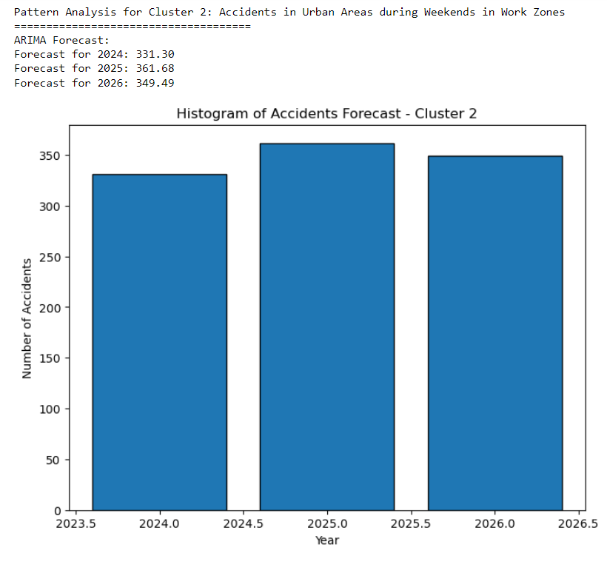
31/10/2023
22

Slide 23


90% Completion OF THE PROJECT
31/10/2023
23

Slide 24


31/10/2023
24

Slide 25


31/10/2023
25

Slide 26
Final completion
31/10/2023
26

Slide 27
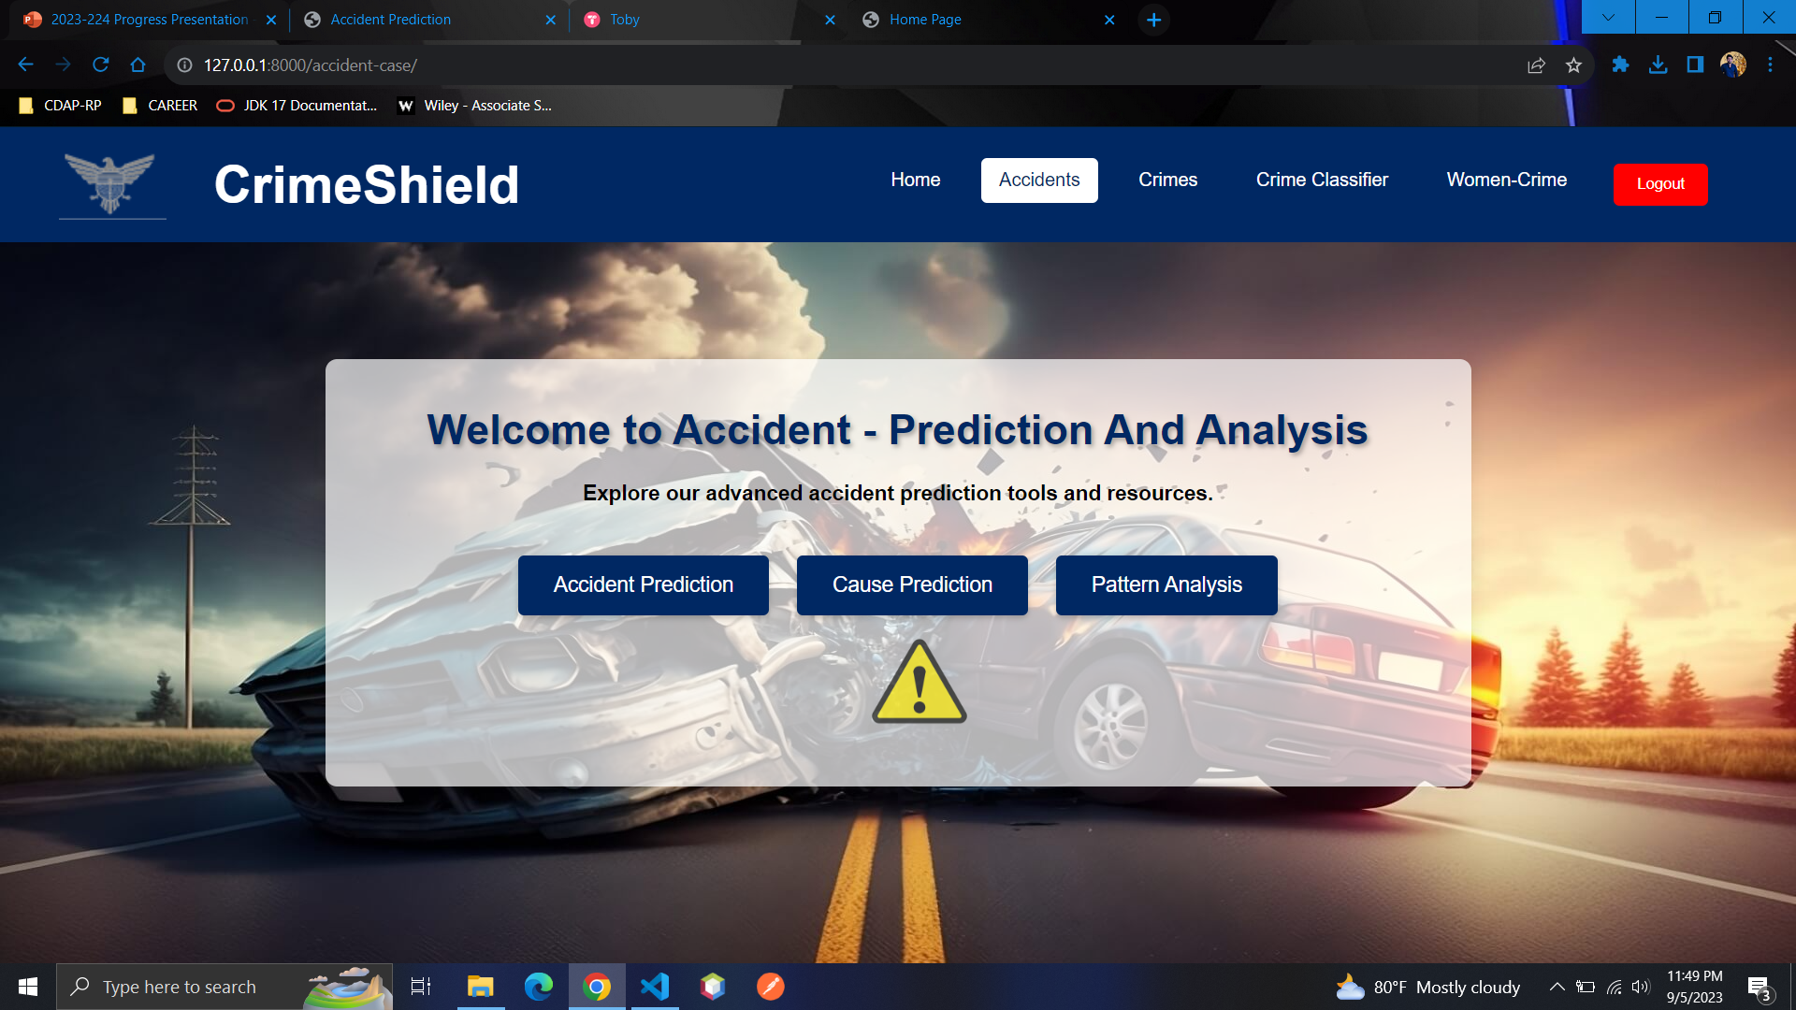
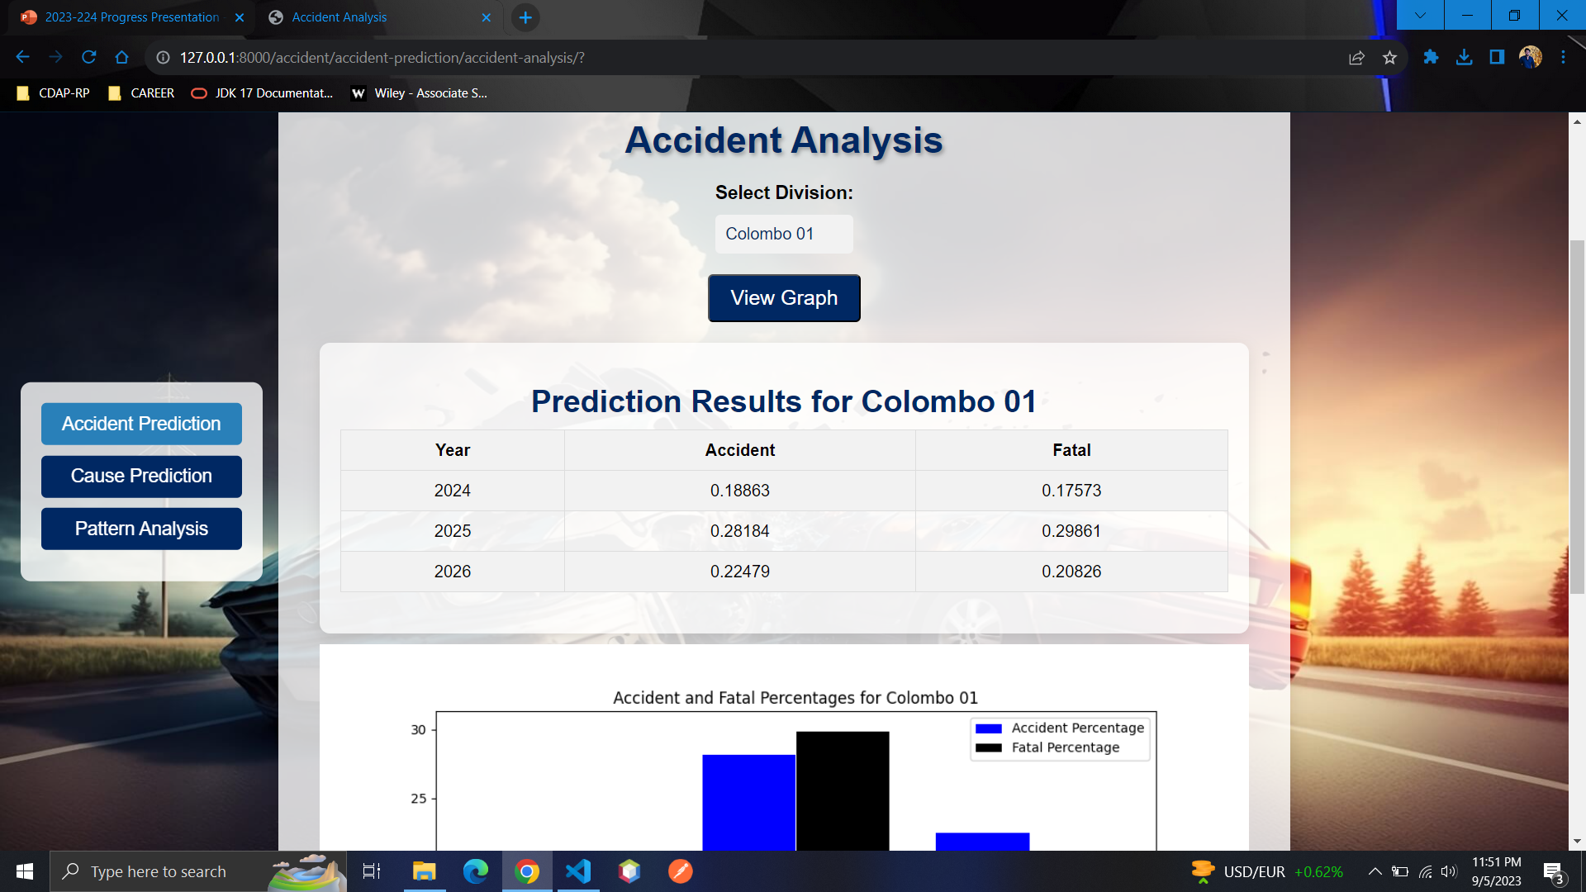
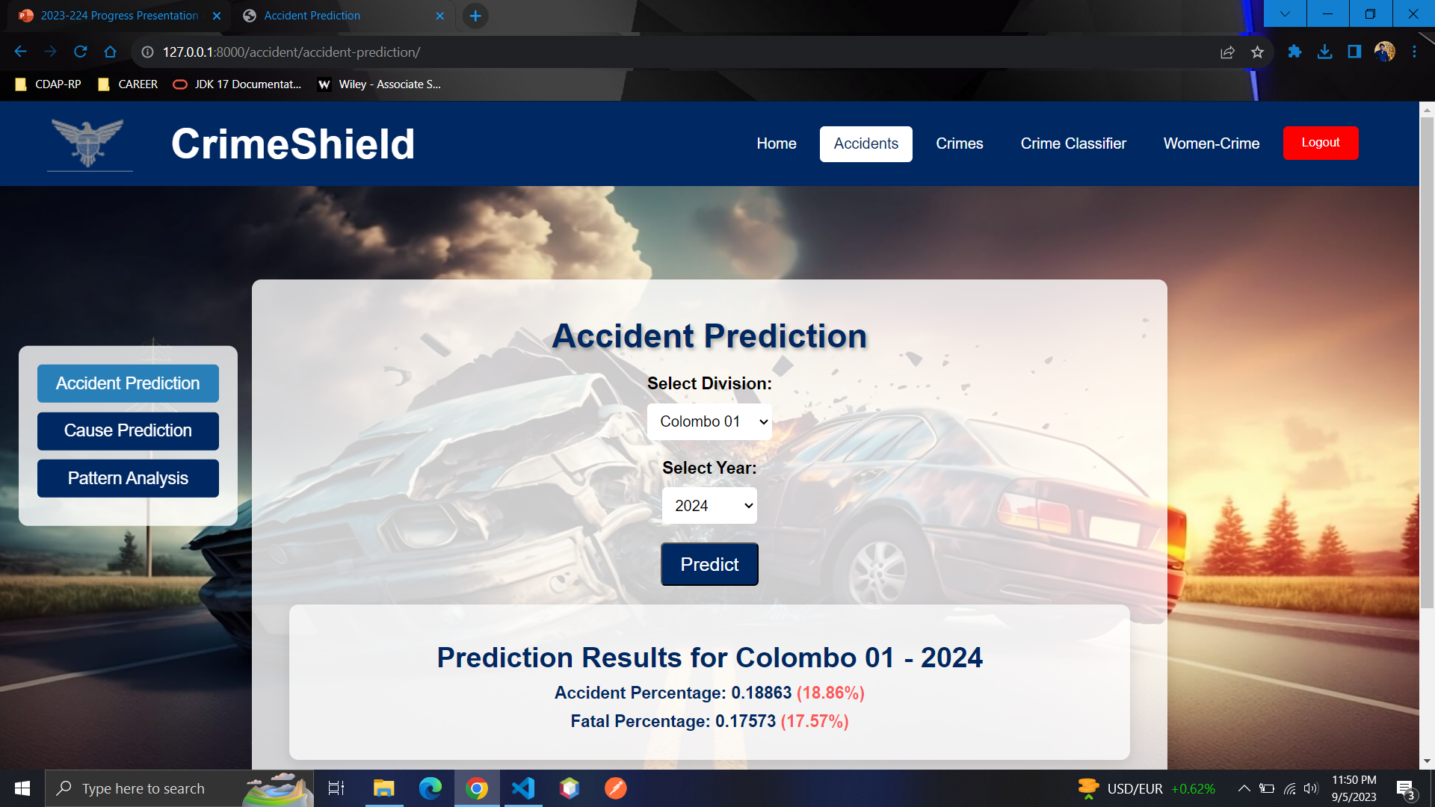
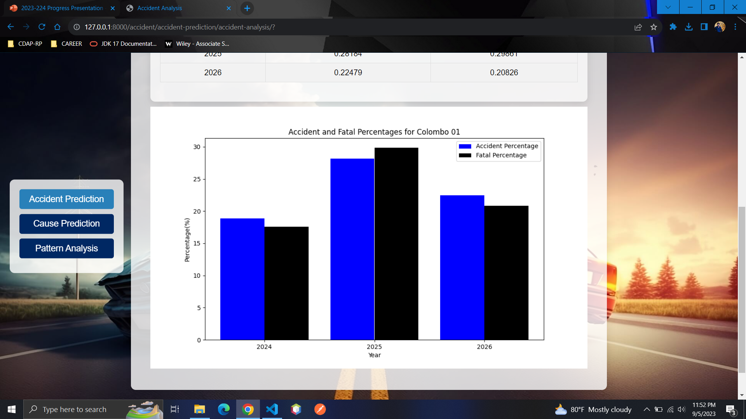
31/10/2023
27

Slide 28
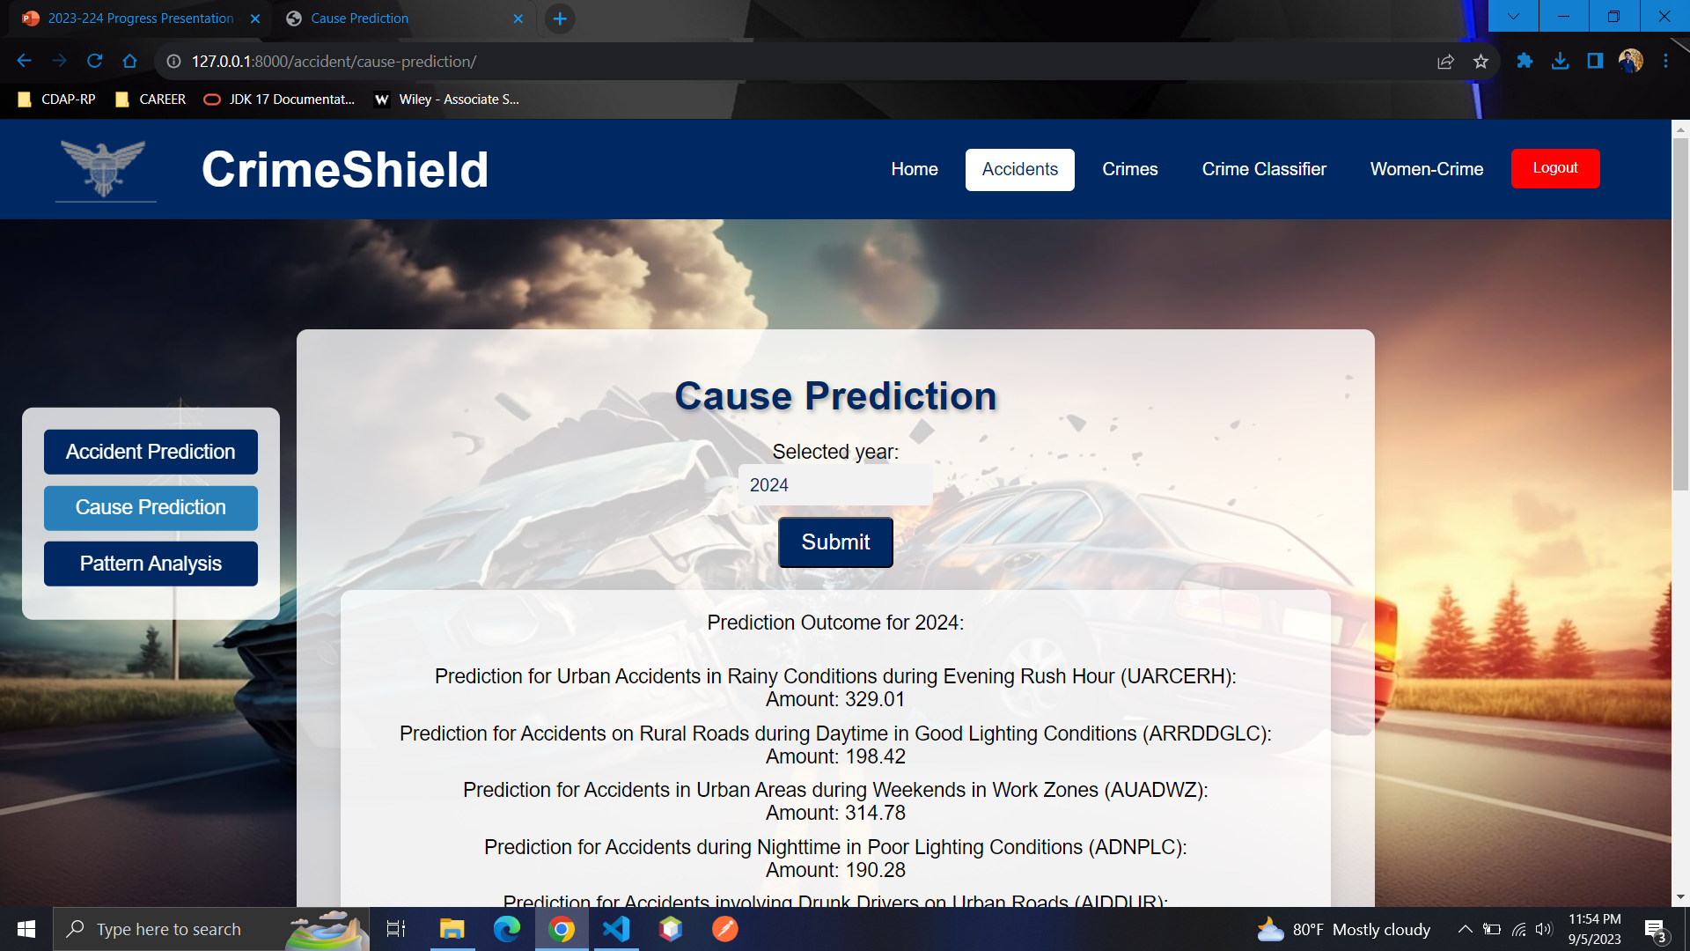
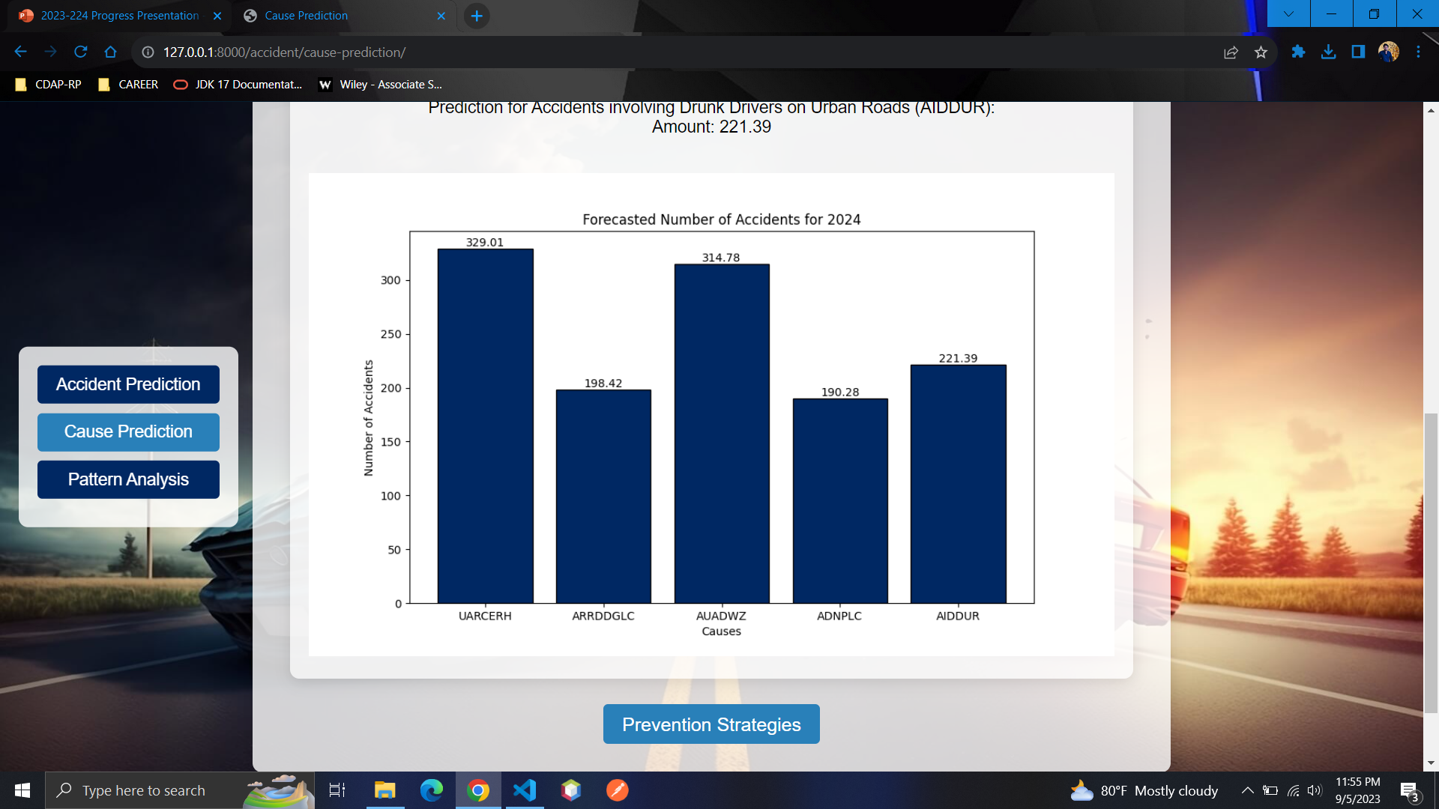
31/10/2023
28

Slide 29
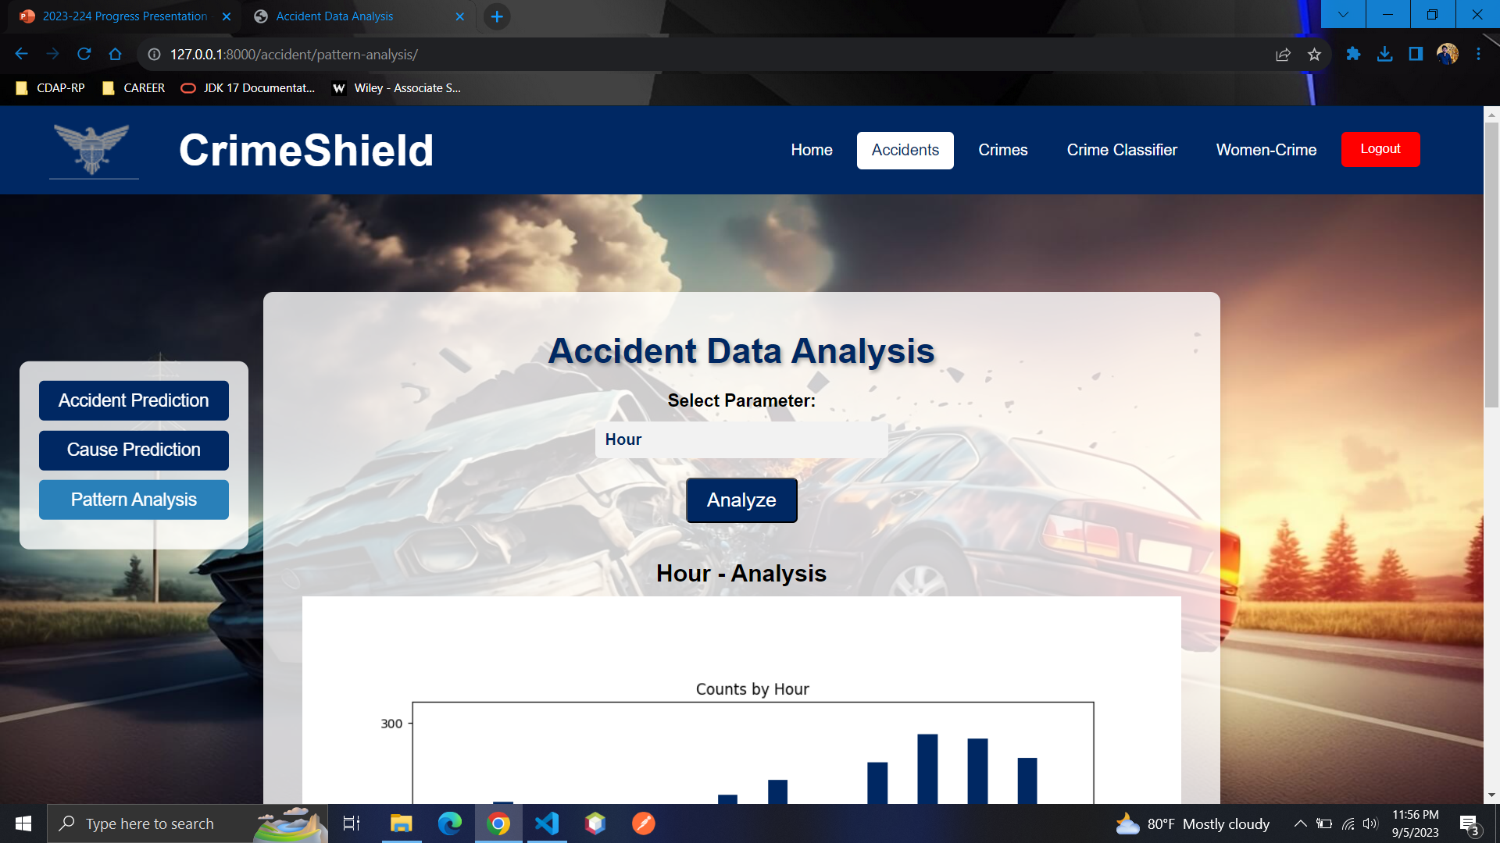
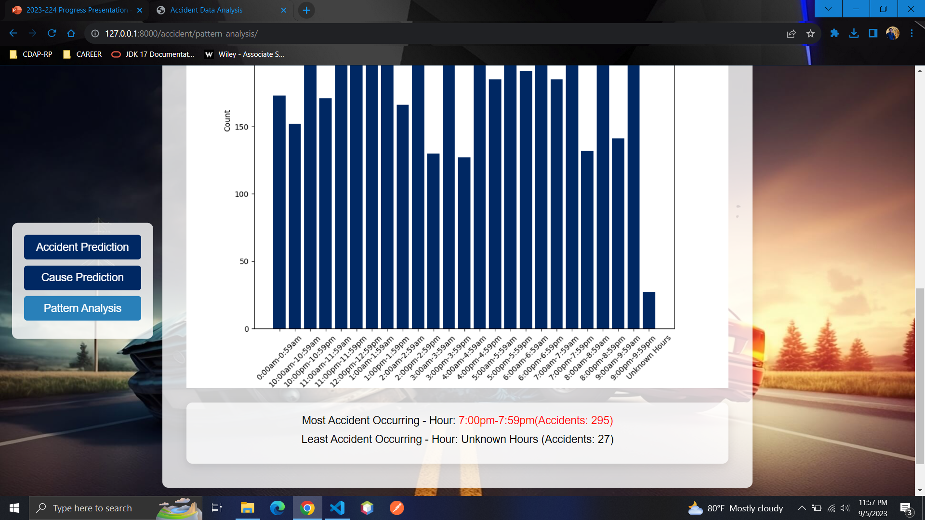
31/10/2023
29

Slide 30
REFERENCES
[1] Fisher, B. S., & Lab, S. P. (2010). Encyclopedia of victimology and crime prevention. Sage Publications.
[2] Hoque, N., & Khan, M. A. (2018). Accident analysis and prevention by machine learning approaches: A systematic review. Safety science, 105, 225-244.
[3] Sivarajah, U., Kamal, M. M., Irani, Z., & Weerakkody, V. (2017). Critical analysis of big data challenges and analytical methods. Journal of Business Research, 70, 263-286.
[4] Choudhury, P., & Kshirsagar, M. (2019). Automated document classification and categorization for crime investigation using machine learning. In Advances in Signal Processing and Intelligent Recognition Systems (pp. 527-538). Springer.
[5] Arora, R., & Pandey, A. K. (2021). A comprehensive review on clustering and forecasting techniques in crimes against women. Pervasive and Mobile Computing, 79, 101607.
[6] Zhang, J., Qin, Z., & Liu, X. (2021). Machine learning techniques for predicting crime: A systematic review. Expert Systems with Applications, 167.
[7] R. Polikar, "Ensemble based systems in decision making," IEEE Circuits and Systems Magazine, vol. 6, no. 3, pp. 21-45, 2006.
31/10/2023
30

Slide 31
REFERENCES
[8] World Health Organization. (2021). Road traffic injuries. https://www.who.int/news-room/fact-sheets/detail/road-traffic-injuries.
[9] He, J., & Wu, J. (2019). Using machine learning to predict road accidents: A review of recent studies. Journal of Advanced Transportation, 2019.
[10] Wan, J., Zhang, D., Li, D., & Liu, C. (2019). Road traffic accident prediction using machine learning: A review. Sustainability, 11(20), 5754.
[11] Chai, Y., Li, H., Wang, Z., & Li, K. (2017). Clustering-based hotspot identification for road traffic accidents: A review of methodological progress and existing issues. International Journal of Environmental Research and Public Health, 14(6), 651.
[12] Zhang, X., Qu, X., & Zhang, X. (2019). A decision tree-based approach for predicting road traffic accident severity. IEEE Access, 7, 58608-58616.
[13] Zhang, Y., & Wang, W. (2019). Identifying risk factors for pedestrian crashes using network analysis of big data. Journal of Advanced Transportation, 2019.
31/10/2023
31

Slide 32

IT19980928
KRISHANTHINI.M
Specialization: Software Engineering​
31/10/2023
32

Slide 33
01
02
Introduction
03
04
background
research problem
objectives
methodology
COMPLETION of the project
05
31/10/2023
33

Slide 34

background
Understanding criminal patterns and trends is important for police to combat widespread criminal activity.
It can be challenging for investigators to go through vast amounts of data manually to identify patterns and connections that could help solve a case.
The utilization of machine learning in criminal case analysis.
31/10/2023
34

Slide 35

Research problem
What is the importance of technology-based methods in predicting future criminal activities based on the nature of the crime?
Why Current manual methods of analysis are inefficient and often lead to inaccuracies in investigate cases?
How Machine learning algorithm could be used to develop an automated system for analyzing criminal cases?
31/10/2023
35

Slide 36
objectives
main objective
Sub objectives
Predicting Crime rates for all the crimes for a Location in a specific Year
Criminal case analysis System for Police to predicting future crimes cases through identifying patterns and trends in terms of nature of the crime.
Predicting the Crime rates for next five years.
31/10/2023
36

Slide 37
01
02
METHODOLOGY
03
04
SYSTEM DIAGRAM
TECHNOLOGIES
REQUIREMENTS
WBS
05
GANTT CHART
31/10/2023
37

Slide 38
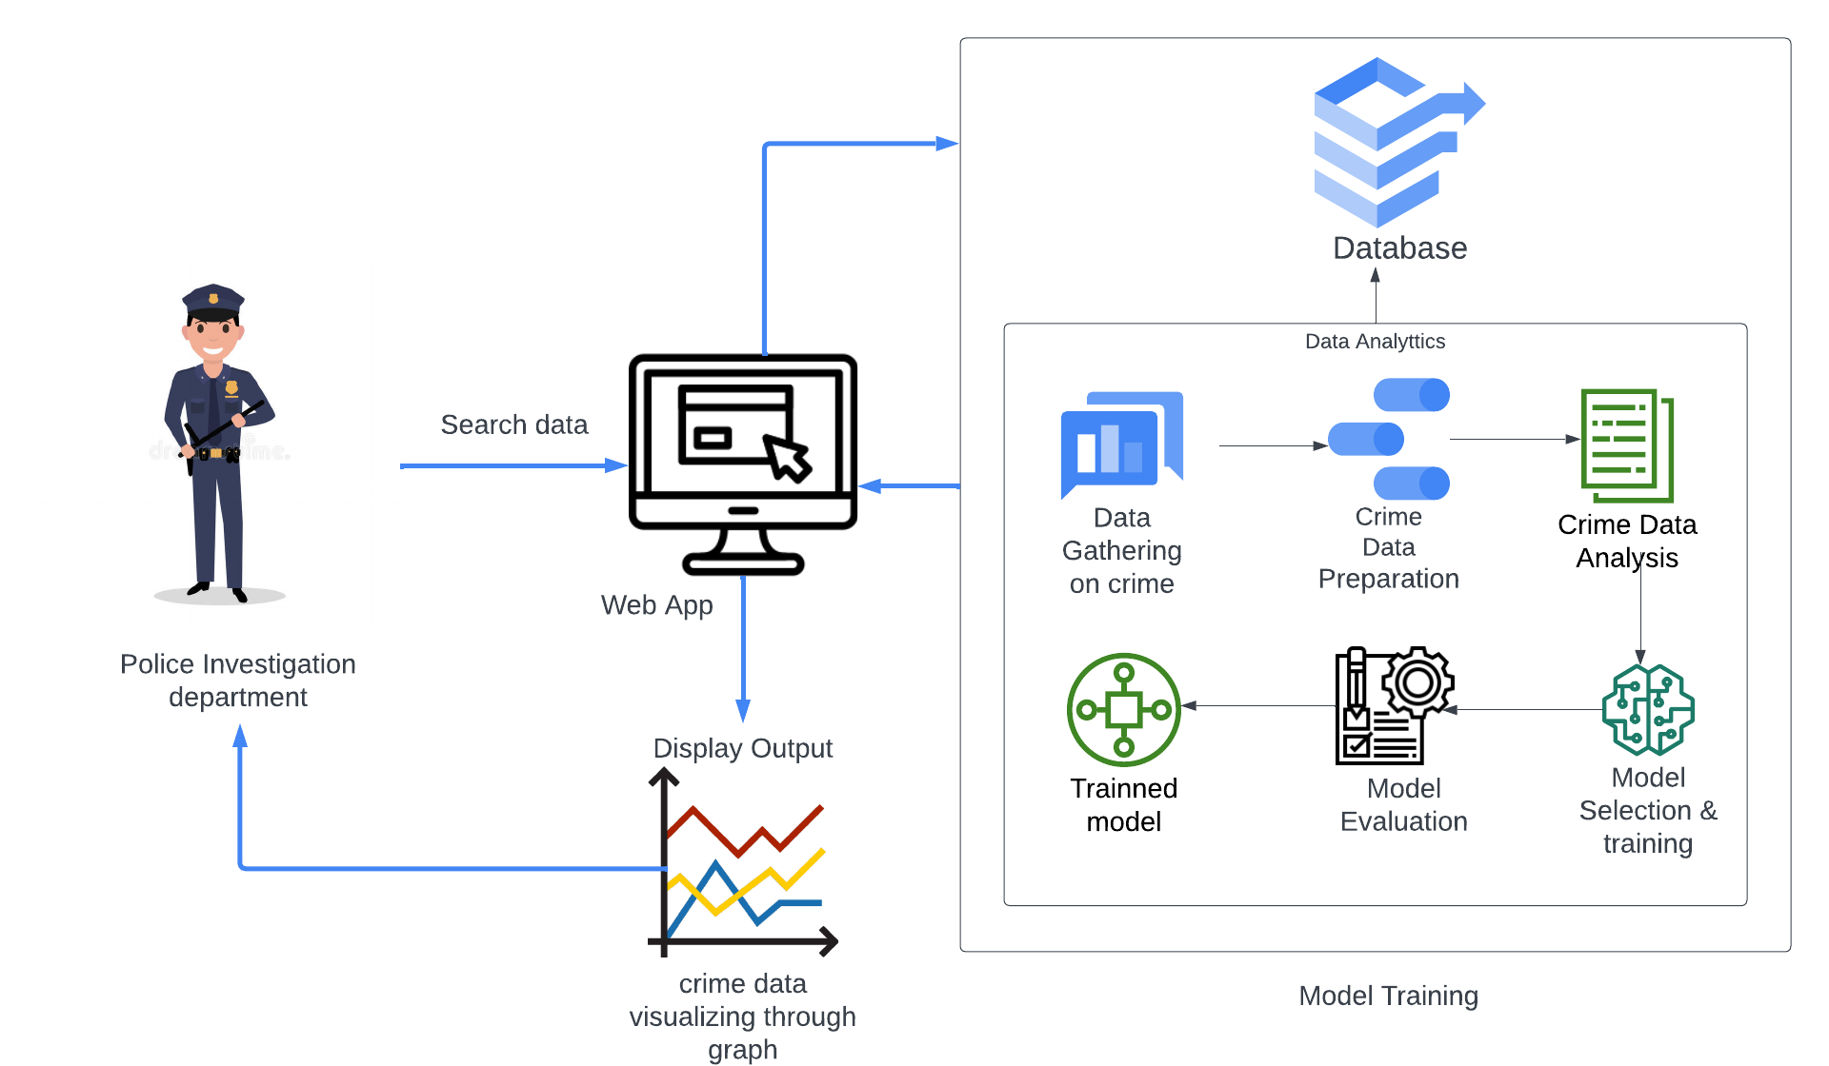
system diagram
31/10/2023
38

Slide 39
TECHNOLOGIES
31/10/2023
39

Slide 40
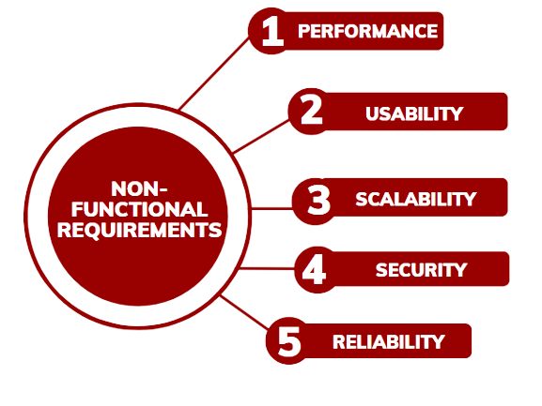
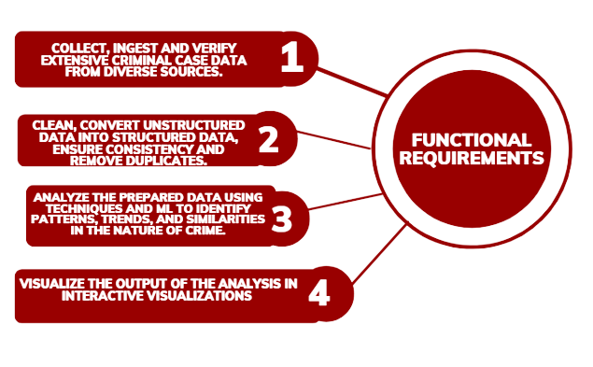

REQUIREMENTS
31/10/2023
40

Slide 41
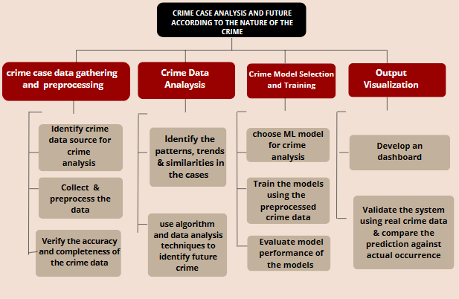
WBS
31/10/2023
41

Slide 42
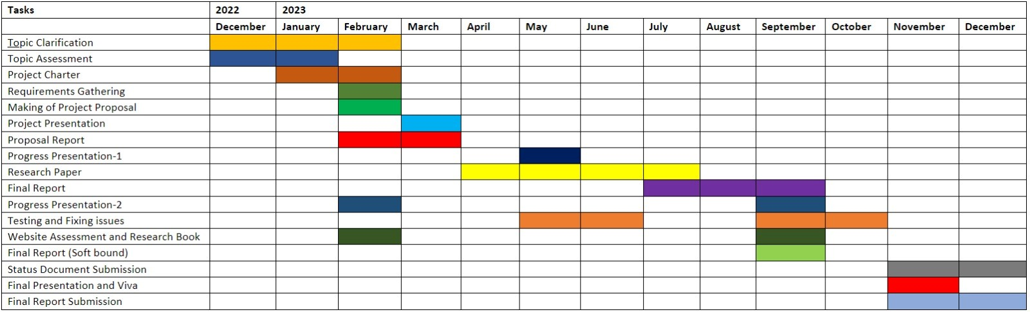
GANTT CHART
31/10/2023
42

Slide 43
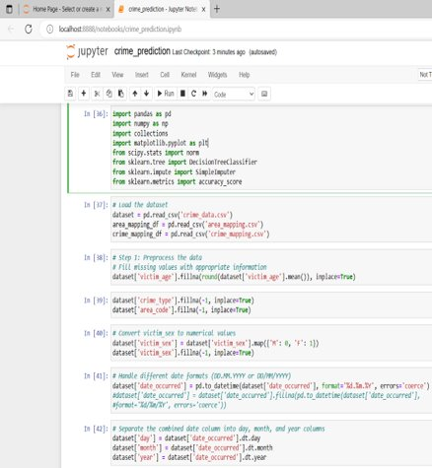
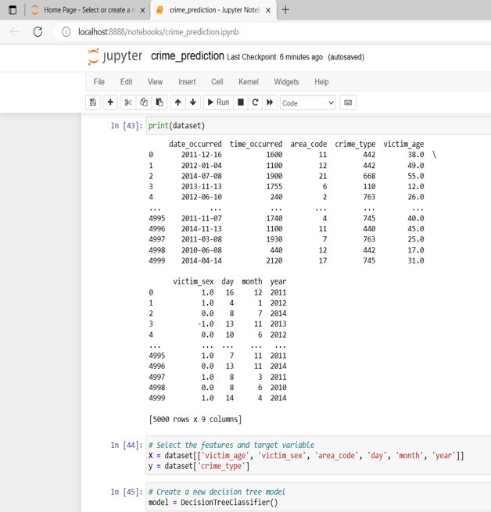
50% Completion OF THE PROJECT
31/10/2023
43

Slide 44
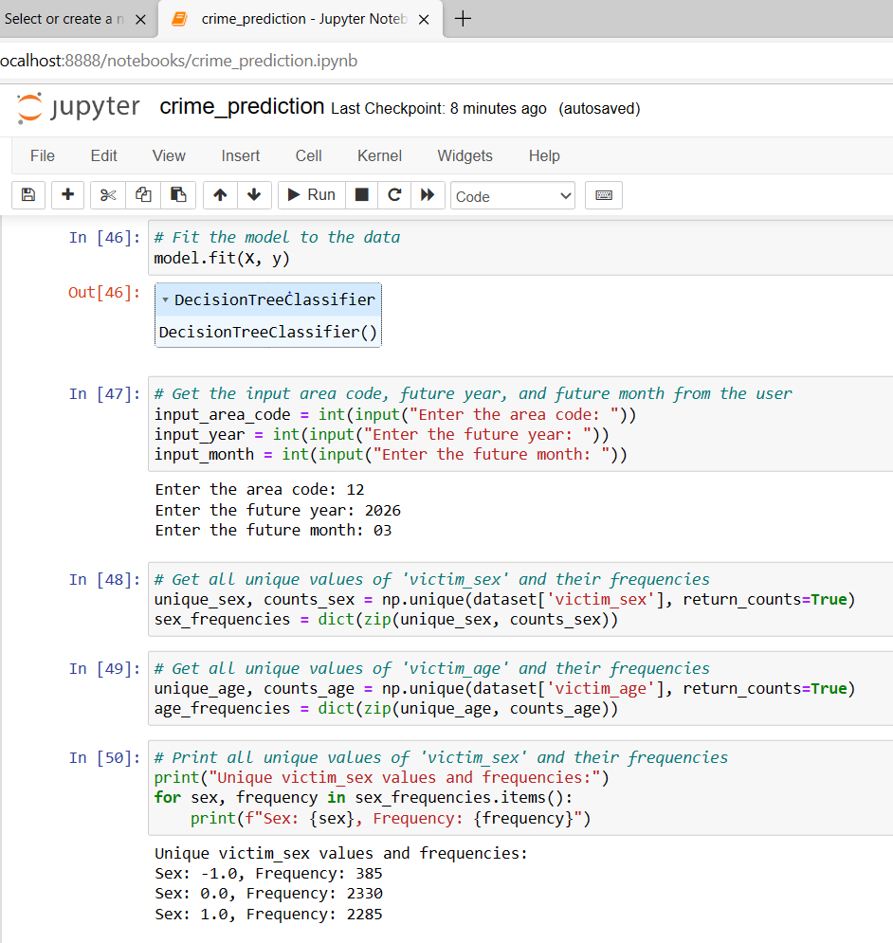
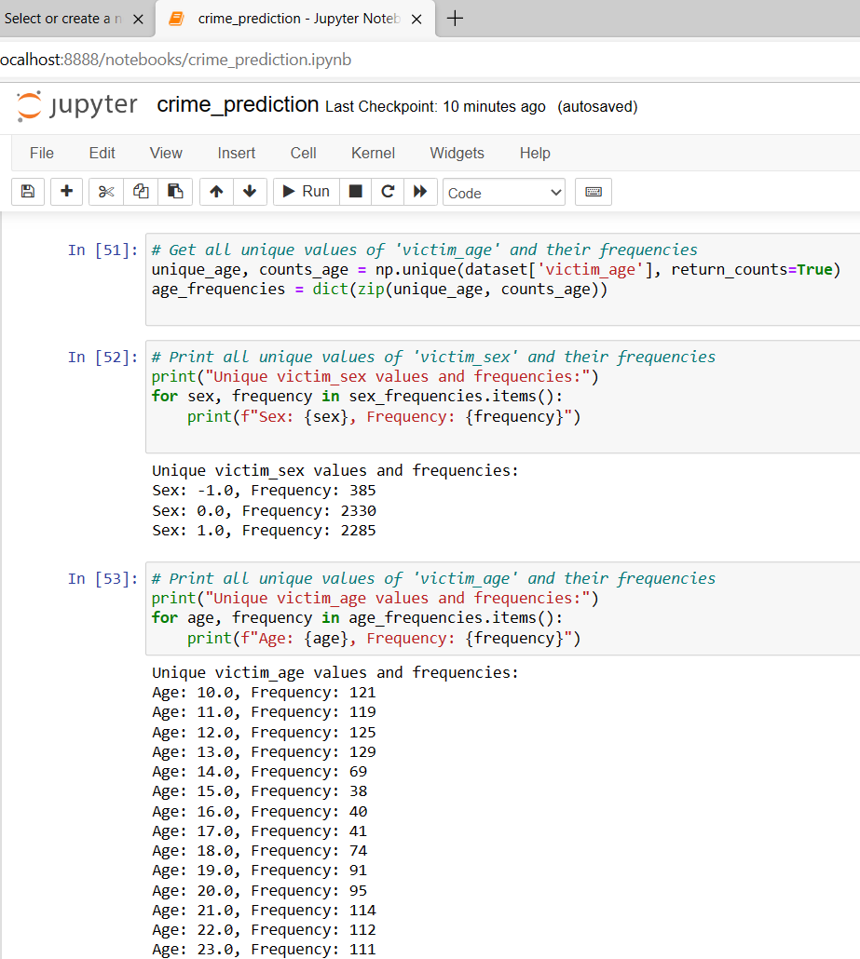
31/10/2023
44

Slide 45
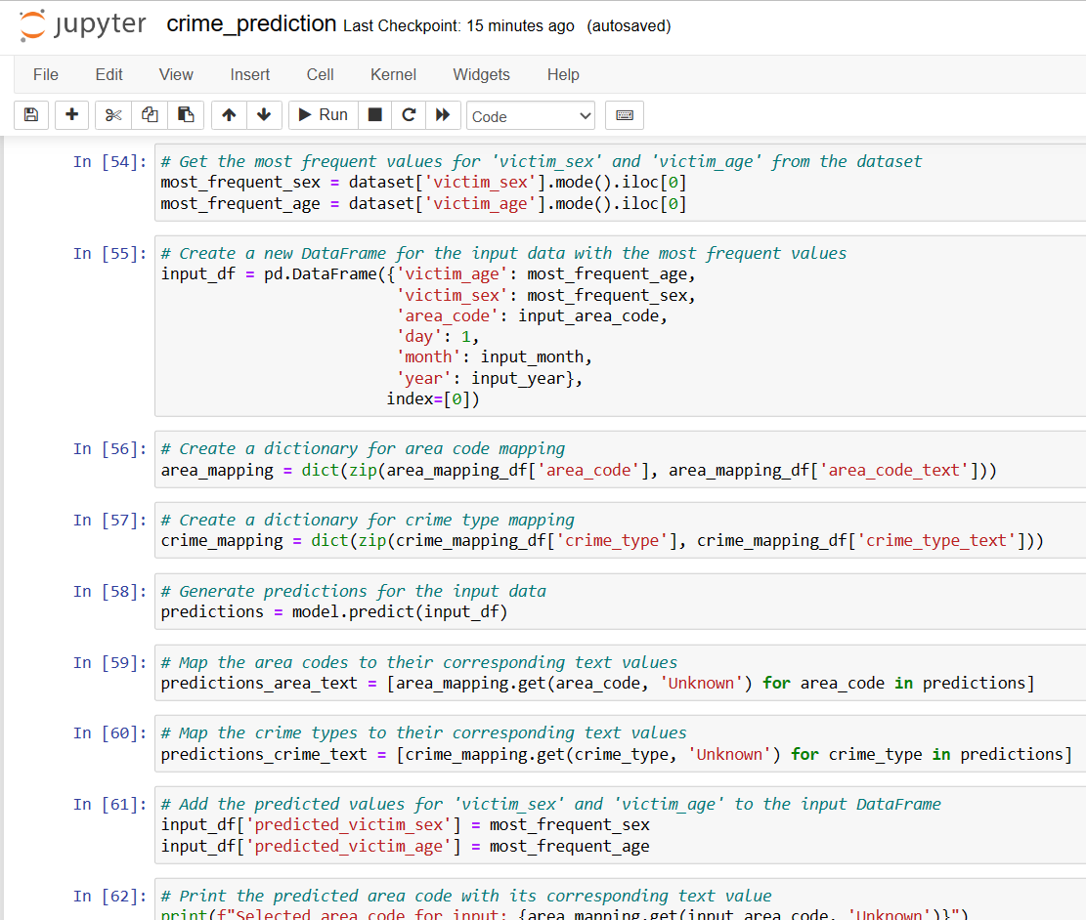
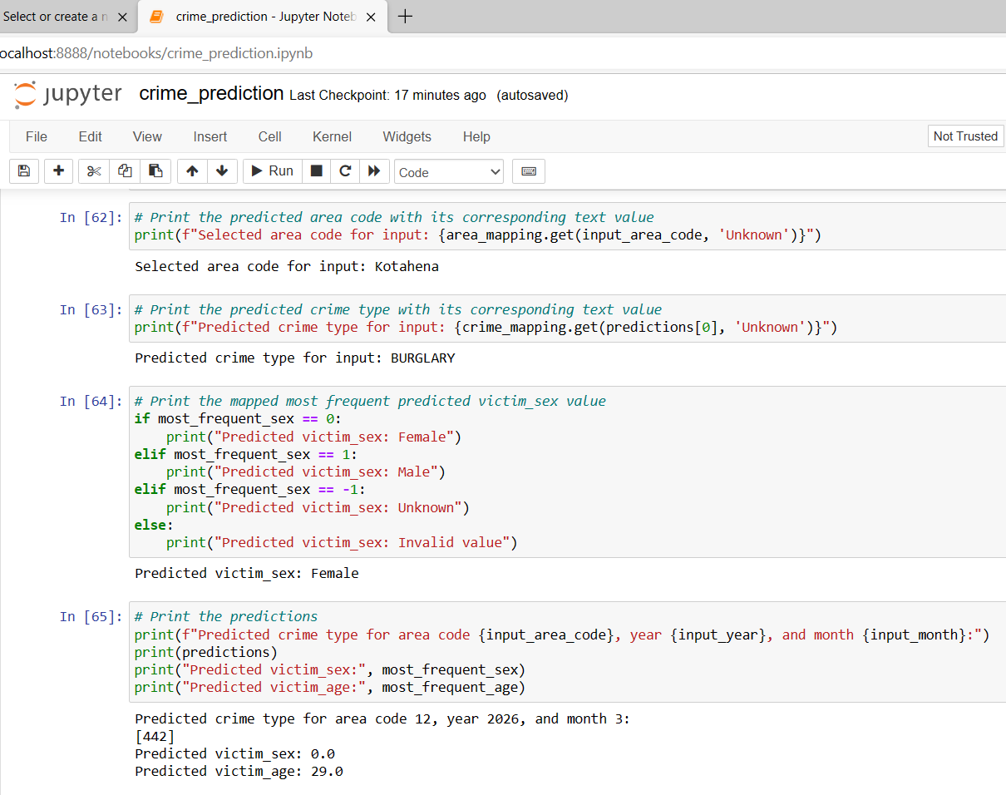
31/10/2023
45

Slide 46
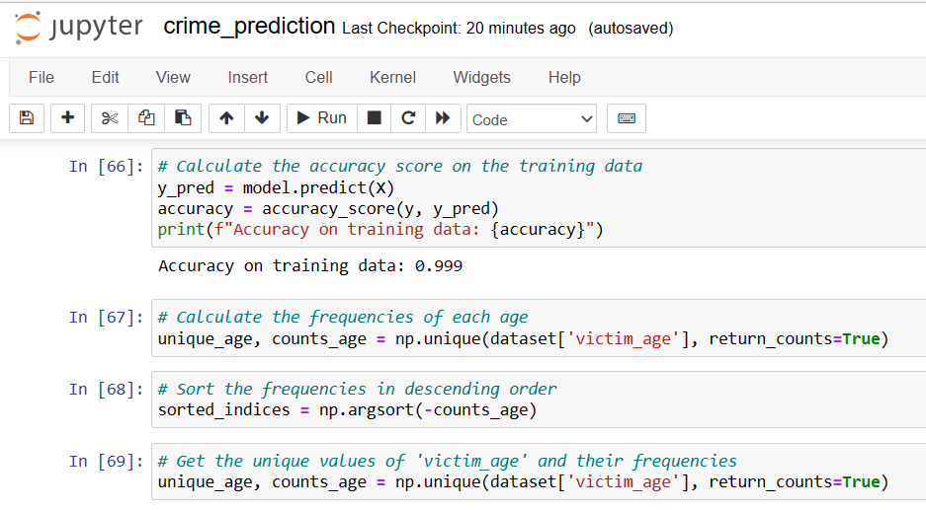
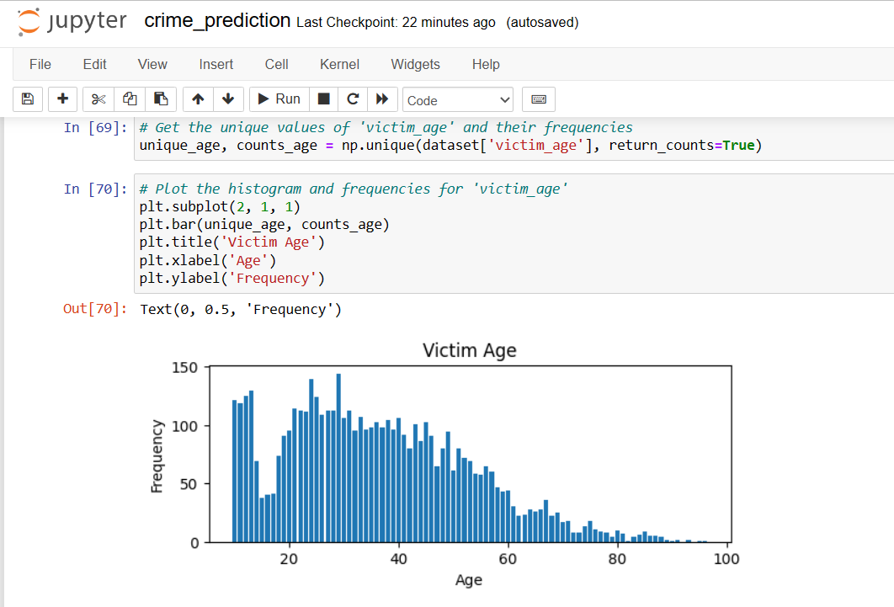
31/10/2023
46

Slide 47


90% Completion OF THE PROJECT
31/10/2023
47

Slide 48


90% Completion OF THE PROJECT
31/10/2023
48

Slide 49


90% Completion OF THE PROJECT
31/10/2023
49

Slide 50
USER INTERFACE IMPLEMENTATION
31/10/2023
50

Slide 51
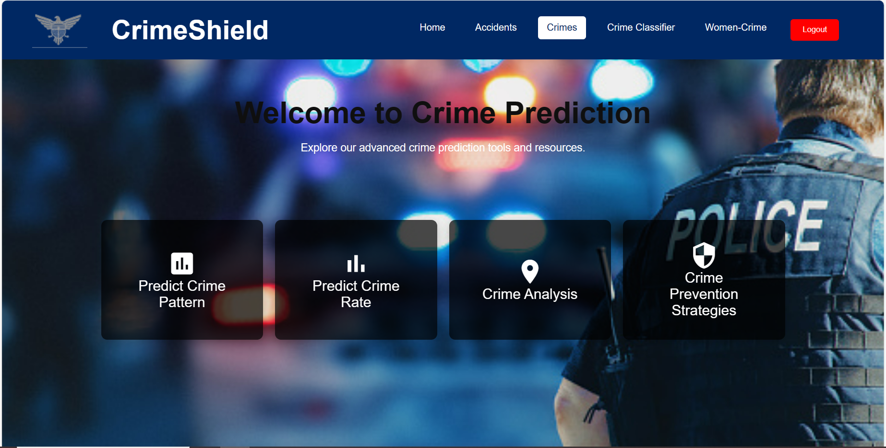
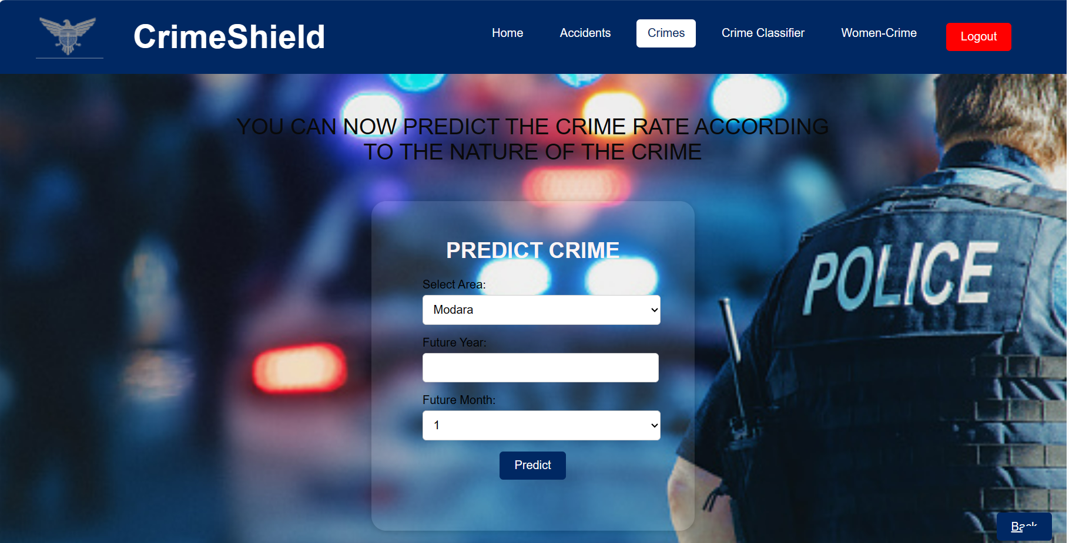
31/10/2023
51

Slide 52
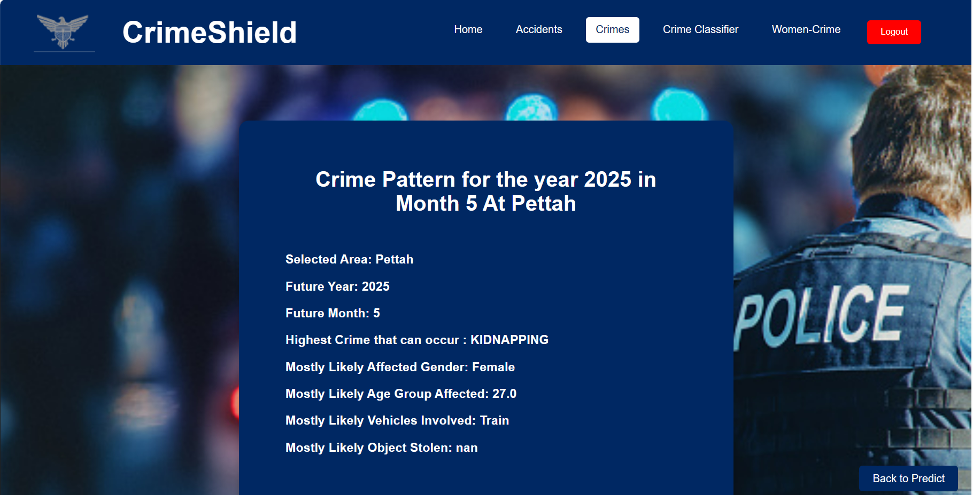
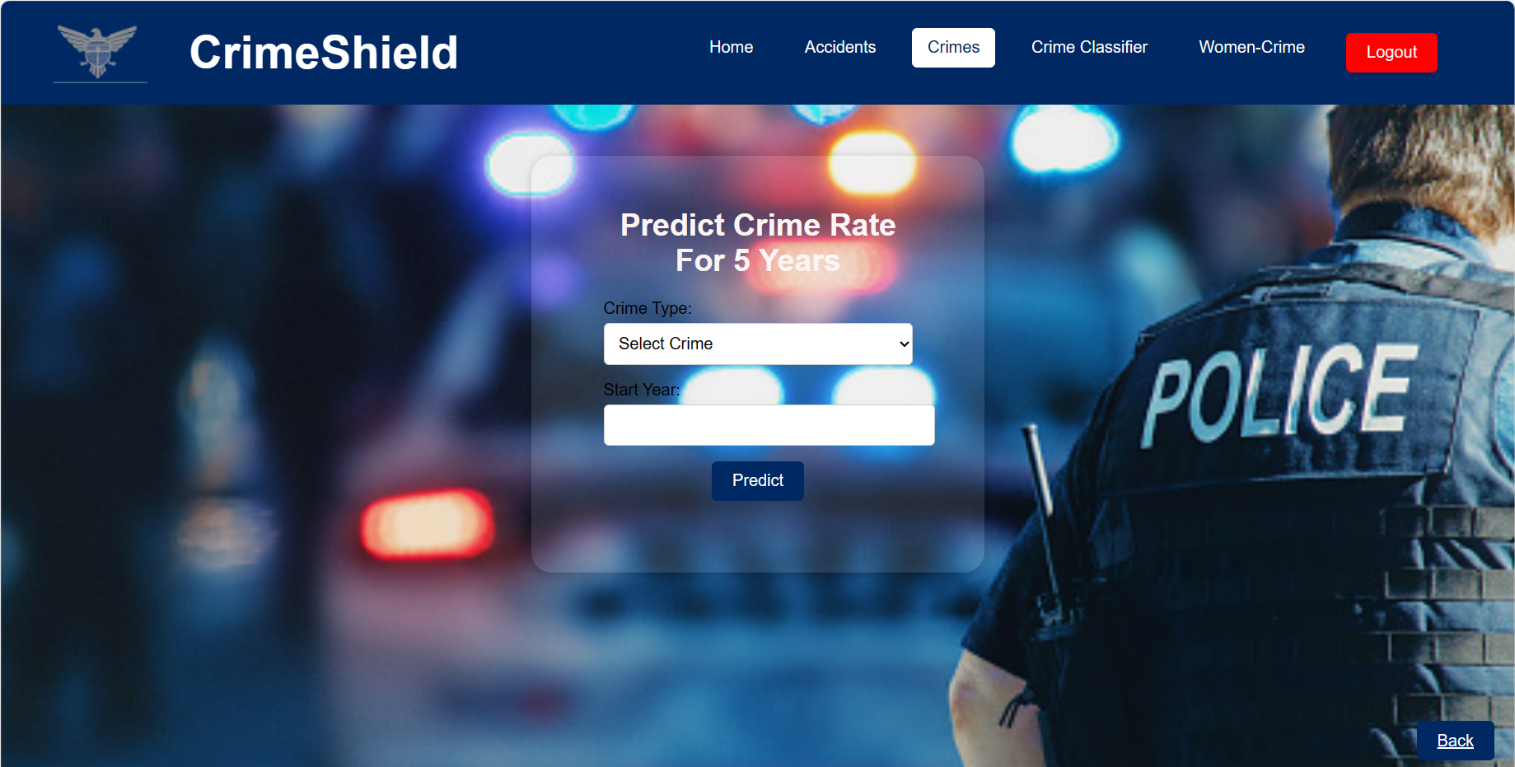
31/10/2023
52

Slide 53
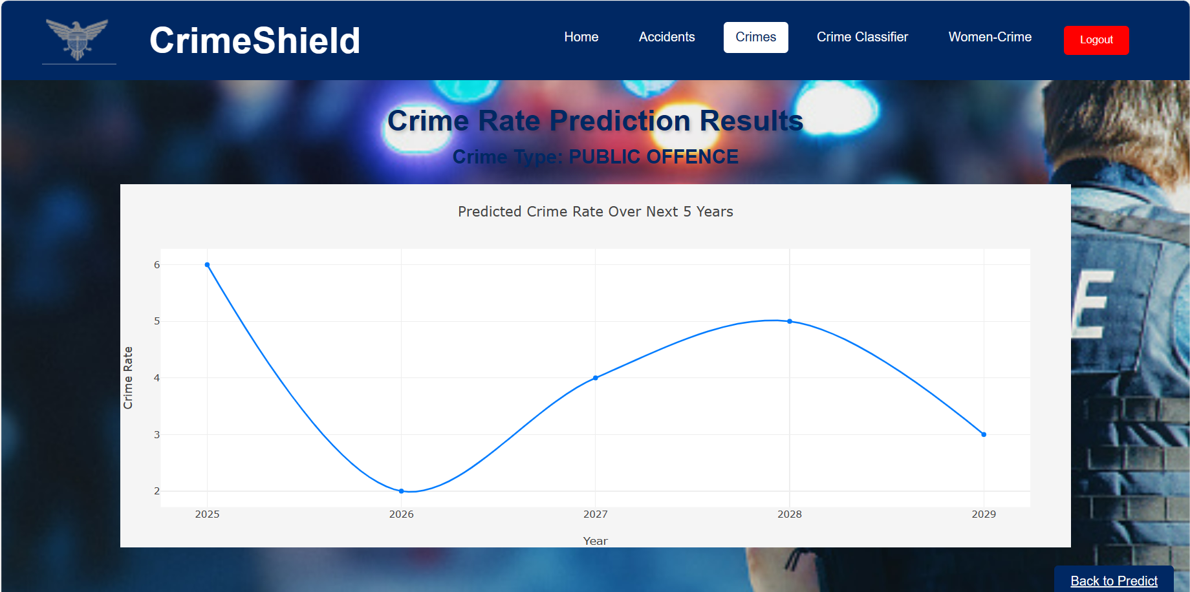
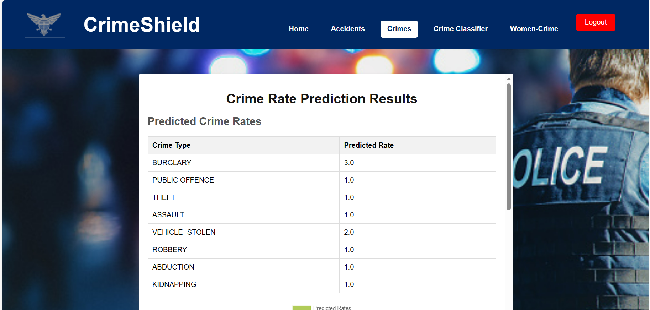
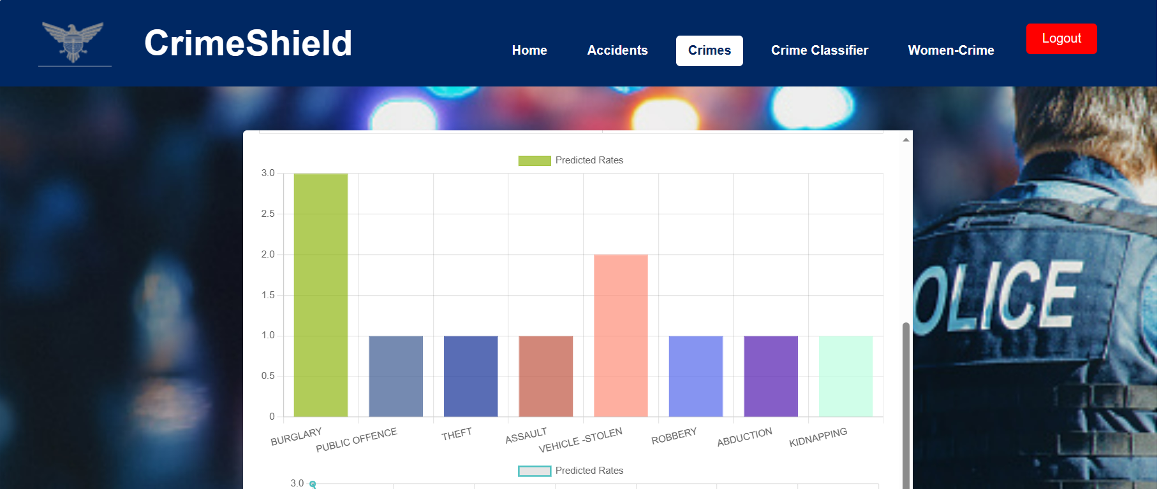
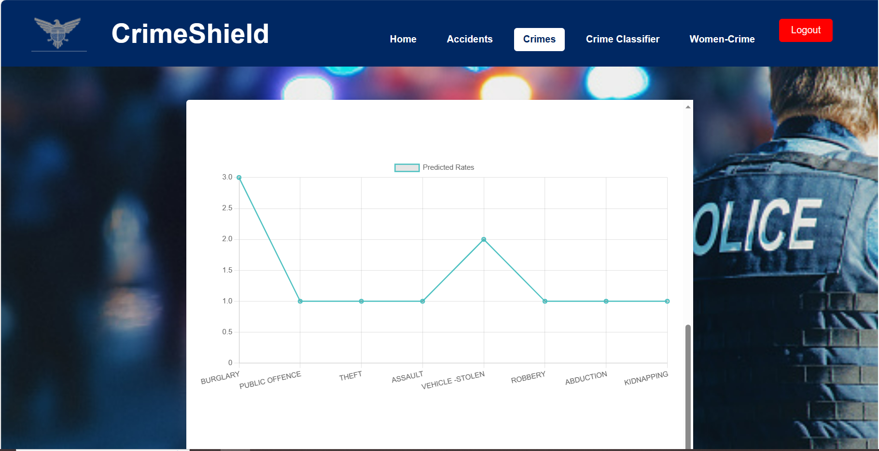
31/10/2023
53

Slide 54
REFERENCES
[1] Karabo Jenga, Cagatay Catal , and Gorkem Kar , "Crime forecasting: A machine learning and computer vision approach to crime prediction and prevention," Journal of Ambient Intelligence and Humanized Computing, vol. 14, no. 10, pp. 4329-4345, 2023. [Online]. Available: https://link.springer.com/article/10.1007/s12652-023-04530-y.
[2] Shah, N., Bhagat, N., & Shah, M. (2020). Crime forecasting using machine learning and computer vision. Journal of Ambient Intelligence and Humanized Computing, 11(9), 3697- 3705.
[3] Walczak, S. (2019). Predicting the types of crimes committed in the city of Chicago using neural networks. Neural Computing and Applications, 31(8), 3795-3802.
[4] Mohler, G. O., Short, M. B., Brantingham, P. J., Schoenberg, F. P., & Tita, G. E. (2011). Self-exciting point process modeling of crime. Journal of the American Statistical Association, 106(493), 100-108.
[5] Kim, S., Joshi, P., Kalsi, P. S., & Taheri, P. (2015). Crime prediction using decision trees. Proceedings of the 2015 IEEE/ACM International Conference on Advances in Social Networks Analysis and Mining (ASONAM), 1285-1292. DOI: 10.1109/ASONAM.2015.7339281
[6] Wang, X., Bai, Y., & Shi, H. (2019). A novel crime pattern detection algorithm based on machine learning. Future Generation Computer Systems, 99, 139-146.
31/10/2023
54

Slide 55
REFERENCES
[7] Johnson, S. D., Bowers, K. J., & Pease, K. (2014). Predictive mapping of crime by ProMap: Accuracy, units of analysis, and the environmental backcloth. Journal of Quantitative Criminology, 30(2), 165-187.
[8] Xu, X., Jiang, C., Cai, Q., & Zhang, H. (2019). Machine learning for crime analysis: a systematic literature review. Journal of Ambient Intelligence and Humanized Computing, 10(5), 1815-1834.
[9] Li, Y., Li, X., Gao, J., Liu, J., & Li, Y. (2021). Crime hotspots detection using machine learning and social media. IEEE Access, 9, 59554-59563.
[10] Porta, J. M., & Crucitti, P. (2017). Urban crime prediction through machine learning techniques. Applied Geography, 88, 61-70.
[11] Zheng, J., Zhao, Z., & Zhang, C. (2019). Crime prediction based on machine learning: A systematic literature review. Computers, Materials & Continua, 59(2), 597-617.
[12] Moustafa, N., & Slay, J. (2019). A novel hybrid crime prediction model using neural networks and decision trees. Expert Systems with Applications, 123, 299-316.
[13] Macrotrends. (n.d.). Sri Lanka Crime Rate 1960-2021. Retrieved March 19, 2023, from https://www.macrotrends.net/countries/LKA/sri-lanka/crime-rate-statistics
31/10/2023
55

Slide 56

IT20001452
TRAVEENA.C
Specialization: Software Engineering​
31/10/2023
56

Slide 57
01
02
Introduction
background
research problem
OBJECTIVES
03
METHODOLOGY
04
Completion of the project
05
31/10/2023
57

Slide 58
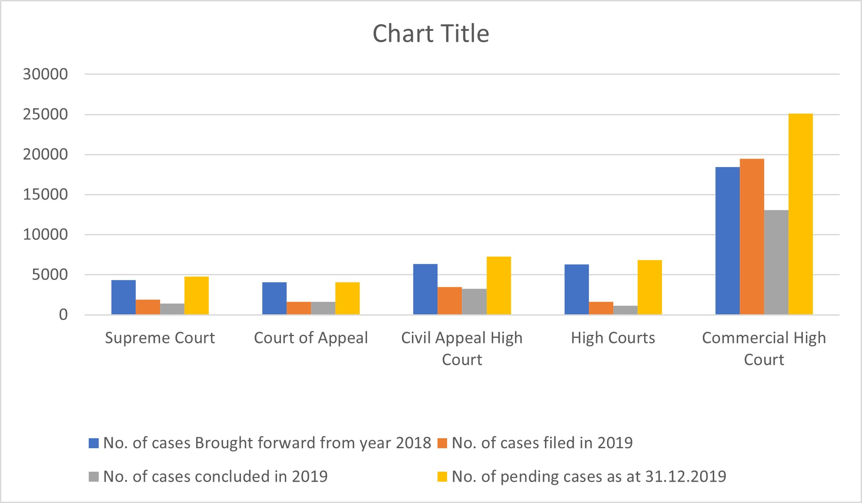
background
Machine learning can improve crime analysis and assist in preventing and investigating crimes.
An automated text analysis system can enhance the investigation process by identifying patterns and extracting relevant information from unstructured text data.
Implementing this system in Sri Lanka would reduce backlog, increase efficiency and accuracy, and ensure justice for victims and their families.
Case Statistic – Sri Lanka 2019
31/10/2023
58

Slide 59
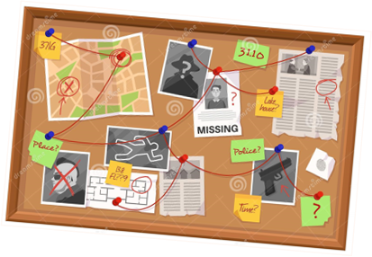
Research problem
What are the specific challenges faced by law enforcement agencies and the court system in Sri Lanka regarding the handling of criminal cases?
What are the current challenges in the criminal case handling procedure in Sri Lanka, and how do they impact the judicial system?
How can an automated text analysis system assist in improving the efficiency and accuracy of the criminal justice system in Sri Lanka?
31/10/2023
59

Slide 60

objectives
main objective
Sub objectives
Develop an automated text analysis system that classifies crime occurrences into relevant categories for law enforcement agencies in Sri Lanka which helps to improve the accuracy and quality of criminal investigations.
Analyze crime case documents to find similarities.
Classify documents of crime cases based on similarities found.
31/10/2023
60

Slide 61
01
02
METHODOLOGY
03
04
SYSTEM DIAGRAM
TECHNOLOGIES
REQUIREMENTS
WBS
31/10/2023
61

Slide 62
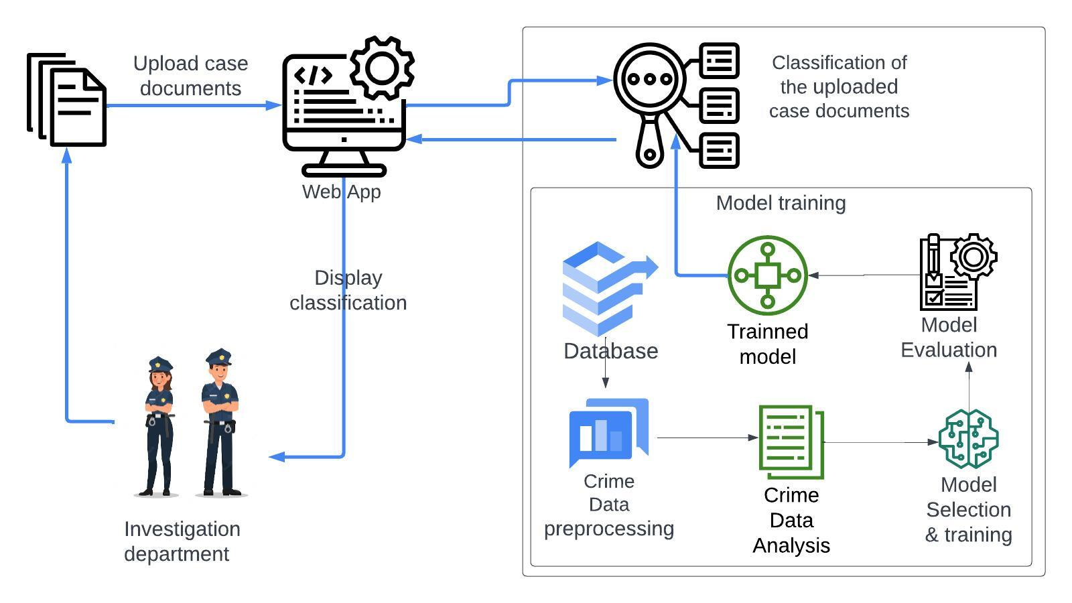
system diagram
31/10/2023
62

Slide 63



TECHNOLOGIES
31/10/2023
63

Slide 64
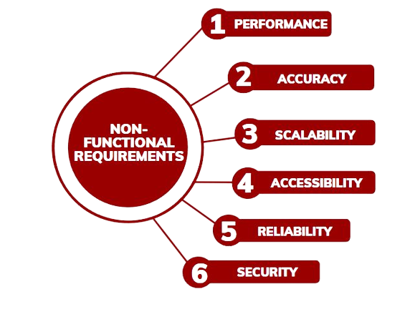

REQUIREMENTS
31/10/2023
64

Slide 65

WBS
CLASSIFING CRIME Cases
31/10/2023
65

Slide 66
GANTT CHART
31/10/2023
66

Slide 67
Completion of code
31/10/2023
67

Slide 68



50% Completion OF THE PROJECT​
31/10/2023
68

Slide 69


31/10/2023
69

Slide 70


31/10/2023
70

Slide 71


90% Completion OF THE PROJECT​
31/10/2023
71

Slide 72


31/10/2023
72

Slide 73



31/10/2023
73

Slide 74
Final completion
31/10/2023
74

Slide 75


31/10/2023
75

Slide 76


31/10/2023
76

Slide 77


31/10/2023
77

Slide 78
REFERENCES
[1] Chih-Hao Ku, Gondy Leroy, A decision support system: Automated crime report analysis and classification for e-government, Government Information Quarterly, Volume 31, Issue 4, 2014, Pages 534-544, ISSN 0740 624X, https://doi.org/10.1016/j.giq.2014.08.003. https://www.sciencedirect.com/science/article/pii/S0740624X14001282
[2] Dahbur, K., Muscarello, T. Classification System for Serial Criminal Patterns. Artificial Intelligence and Law 11, 251–269 (2003). https://doi.org/10.1023/B:ARTI.0000045994.96685.21
[3] S. Ghankutkar, N. Sarkar, P. Gajbhiye, S. Yadav, D. Kalbande and N. Bakereywala, "Modelling Machine Learning For Analysing Crime News," 2019 International Conference on Advances in Computing, Communication and Control (ICAC3), Mumbai, India, 2019
https://ieeexplore.ieee.org/abstract/document/9036769
[4] Z. Qi, "The Text Classification of Theft Crime Based on TF-IDF and XGBoost Model," 2020 IEEE International Conference on Artificial Intelligence and Computer Applications (ICAICA), Dalian, China, 2020, pp. 1241-1246
https://ieeexplore.ieee.org/abstract/document/9182555
[5] M. Alruily, A. Ayesh and H. Zedan, "Crime Type Document Classification from Arabic Corpus," 2009 Second International Conference on Developments in eSystems Engineering, Abu Dhabi, United Arab Emirates, 2009
https://ieeexplore.ieee.org/abstract/document/5395104
31/10/2023
78

Slide 79
REFERENCES
[6] Ch, Rupa, Thippa Reddy Gadekallu, Mustufa Haider Abidi, and Abdulrahman Al-Ahmari. 2020. "Computational System to Classify Cyber Crime Offenses using Machine Learning" Sustainability 12, no. 10: 4087. https://doi.org/10.3390/su12104087
[7] Z. Abbass, Z. Ali, M. Ali, B. Akbar and A. Saleem, "A Framework to Predict Social Crime through Twitter Tweets By Using Machine Learning," 2020 IEEE 14th International Conference on Semantic Computing (ICSC), San Diego, CA, USA, 2020
https://ieeexplore.ieee.org/abstract/document/9031496
[8] Y. Zhang, Q. Wang, X. Ma, and L. Zhang, "Text Classification of Crime Reports Using Machine Learning Techniques," in Proceedings of the 2014 IEEE 26th International Conference on Tools with Artificial Intelligence, Limassol, Cyprus, 2014, pp. 416-423.
[9] Li, S., Feng, Y., Li, Z., & Li, Y. (2019). Research on text clustering and classification of criminal cases. Journal of Computational and Theoretical Nanoscience, 16(9), 3627-3633.
[5] R. Singh, S. S. Rathore, and S. K. Singh, "Crime Classification Using Machine Learning: A Survey," in Proceedings of the 2018 2nd International Conference on Computing Methodologies and Communication, Erode, India, 2018, pp. 186-192. 104
31/10/2023
79

Slide 80


IT20068196
ANUBAMA.L
Specialization: Software Engineering
31/10/2023
80

Slide 81
01
02
Introduction
03
04
background
research problem
objectives
methodology
05
Completion of the project
31/10/2023
81

Slide 82

background
Technology and data analytics are important tools for future crime prevention.
Crimes against women are a significant problem, and prevention and reduction remain challenging due to various factors.
A data-driven crime prevention system using machine learning algorithms and vast amounts of datasets could be an effective solution for reducing crime, including crimes against women.
31/10/2023
82

Slide 83

Research problem
How can crime forecasting models accurately predict future high-rate crimes, counts and types of crimes against women, and identify high-risk areas for such crimes?
What is the problem with current crime forecasting models in regards to crimes against women?
How can a crime forecasting model contribute to the development of effective crime prevention strategies for crimes against women?
31/10/2023
83

Slide 84
objectives
main objective
Sub objectives
Develop a model for predicting crimes against women.
Provide information on the locations ,year and types of crimes against women.
Enable law enforcement agencies to take preventive measures and allocate resources more effectively.
Identifying key characteristics and analyzing historical data to identify.
Evaluate different clustering algorithms to select the most appropriate one to predict future crimes.
Validate the accuracy of the model using statistical tests.
Reading and selecting Data
Handling Missing Values
Preprocessing the Dataset
K-means Clustering
Visualizing Clusters
Build Predictive Model
Model Evaluation
Future Crime Prediction
31/10/2023
84

Slide 85
01
02
METHODOLOGY
03
04
SYSTEM DIAGRAM
TECHNOLOGIES
REQUIREMENTS
WBS
05
GANTT CHART
31/10/2023
85

Slide 86

system diagram
31/10/2023
86

Slide 87


TECHNOLOGIES
31/10/2023
87

Slide 88


REQUIREMENTS
31/10/2023
88

Slide 89

WBS
31/10/2023
89

Slide 90
GANTT CHART
31/10/2023
90

Slide 91
Completion of THE PROJECT
31/10/2023
91

Slide 92



50 % Completion
31/10/2023
92

Slide 93


31/10/2023
93

Slide 94


31/10/2023
94

Slide 95


31/10/2023
95

Slide 96


31/10/2023
96

Slide 97


90 % Completion
31/10/2023
97

Slide 98


90 % Completion
31/10/2023
98

Slide 99

90 % Completion
31/10/2023
99

Slide 100
USER INTERFACE IMPLEMENTATION
31/10/2023
100

Slide 101



31/10/2023
101

Slide 102


31/10/2023
102

Slide 103



31/10/2023
103

Slide 104
REFERENCES
[1] “Developing a Machine Learning Based Support System for Mitigating the Suppression Against Women and Children”https://www.researchgate.net/publication/357724993_Developing_a_Machine_Learning_Based_Support_System_for_Mitigating_the_Suppression_Against_Women_and_Children
[2]“Who women violence,” available onhttps://www.who.int/news-room/fact-sheets/detail/violence-against-women [Online, Accessed: 2021-07-15].
[3] P. Patil, "K Means Clustering : Identifying F.R.I.E.N.D.S in the World of Strangers," 20 May 2018. [Online]. Available: https://towardsdatascience.com/k‐means‐clustering‐ identifying‐f‐r‐i‐e‐n‐d‐s‐in‐the‐world‐of‐strangers‐695537505d
[4] “Violence against women in the United States,” available on https://centerforfamilyjustice.org/community-education/statistics/?fbclid=IwAR1L48Js6P079ZRfLRsslS0zyA8bzLelP0J36la0YiSHgzoCAMxP5kBwMAM ,[Online, Accessed: 2021-07-15].
[5] “UNICEF south Asia,” available onhttps://www.unicef.org/rosa/topics/gender-based-violence , [Online, Accessed: 2021-07-15]
31/10/2023
104

Slide 105
REFERENCES
[6] "Using Clustering and Classification Techniques for Predicting Crime Hotspots" by R. Subramanian and S. Padmavathi. This research paper discusses the use of clustering techniques to identify crime hotspots, and machine learning algorithms for prediction.
[7] "Forecasting Crime using Machine Learning and Social Media" by S. Adhikari et al. This research paper discusses the use of machine learning algorithms for crime prediction using data from social media.
[8] "Predictive Policing: The Role of Crime Forecasting in Law Enforcement Operations" by U. Bhatti and N. Ullah. This book chapter discusses the use of crime forecasting in law enforcement operations, including the use of clustering techniques and machine learning algorithms.
[9]"A Comprehensive study on crime predictive techniques https://www.researchgate.net/publication/226799979_Review_of_Current_Crime_Prediction_Techniques
[10]"Analysis and Prediction of Crimes by Clustering and Classification"
https://www.researchgate.net/publication/281478329_Analysis_and_Prediction_of_Crimes_by_Clustering_and_Classification
31/10/2023
105

Slide 106
REFERENCES
[11] Gracia, E., Fernandez, M. M., Lila, M., Merlo, J., & Ivert, A. K. (2019, 05 16). PLOS ONE. Retrieved 12 16, 2019, from https://journals.plos.org/plosone/article?id=10.1371/journal.pone.0217015
[12] Guruge, S., Illesinghe, V. J., Gunawardhana, N., & Perera, J. (2015). Intimate Partner Violence in Sri Lanka;A scoping review. Ceylon Medical Journal , 60 (4), 6.
[13] Helpguide.org. (2019). Helpguide.org. Retrieved 12 16, 2019, from https://www.helpguide.org/articles/abuse/domestic-violence-and-abuse.htm
[14] Ibe, C. (2017). Harvard Political Review. Retrieved 12 16, 2019, from https://harvardpolitics.com/world/the-nordic-paradox-gender-equity-and-sexual-assault/ Samules, F., Jones, N., & Gupta, T. (2017). Tackling Intimate Partner Violence in South Asia. ODI.[12] S. R. Mahmud, S. N. Tumpa, A. B. Islam, C. N. Ferdous, N. Paul, and T. T. Anannya, “Bonitaa: A smart approach to support the female rapevictims,” in 2017 IEEE Region 10 Humanitarian Technology Conference(R10-HTC). IEEE, 2017, pp. 730–733.
[15] S. I. Ahmed, S. J. Jackson, N. Ahmed, H. S. Ferdous, M. R. Rifat,A. Rizvi, S. Ahmed, and R. S. Mansur, “Protibadi: A platform for ﬁghting sexual harassment in urban bangladesh,” in Proceedings of the SIGCHI Conference on Human Factors in Computing Systems, 2014,pp. 2695–2704.
26/05/2023
106

Slide 107
commercialization
The proposed solution could be customized to meet the specific needs of the police investigation department, considering the unique characteristics of the system. And it is intended to be a service-oriented system.
31/10/2023
107

Slide 108
Thank you.
31/10/2023
108

Slide 109

31/10/2023
109

